Slide 1
Industrial Technology Timber Stage 5
General Wood - Core Module 2
Societal and Environmental Impact

Slide 2
Students learn about: Societal and Environmental Impact | Students learn about: (refer to Outcomes 5.7.1, 5.7.2 )
the effects of the timber industry on society and the environment | describe the use of renewable resources and the impact on the environment

Slide 3
Renewable Resources
A renewable resource is a resource which is replaced naturally and can be used again.
Renewable resources include goods commodities such as wood, paper and leather.
Renewable energy refers to the provision of energy via renewable resources which may be used to run timber industries. Eg. Solar, Wind, Geothermal.
Electric vehicles (EV’s) can also run on renewable energy. Eg. Tractors & Trucks.
Renewable resources of the timber industry

Slide 4
Environmental effects
The timber industry has received much bad publicity in recent decades regarding is destructive nature.
Today most of those concerns have been improved upon.
Most timber is sustainably harvested which means it is treated like a wood farm, we grow what we need.
In Australia most of our sustainable timber is harvested by the state forestry which is a government body, and follows environmental laws.
Effects of the timber industry on the Environment

Slide 5
Environmental effects
Timber is
Natural - Non toxic
Renewable - As long as new trees are planted to replace those harvested
Low in production energy - It takes very little energy to convert the wood in trees to the timber used in building. This means that the embodied energy in timber is very low, the lowest of almost all common building materials.
Effects of the timber industry on the Environment

Slide 6
Environmental effects
Timber is
A store of carbon - Timber is made from carbon drawn from the atmosphere. This carbon would otherwise be adding to the greenhouse effect. Using timber in buildings stores the carbon for as long as the building stands or the timber is used.
A very good insulator - In reducing the amount of energy used to heat and operate a building, insulation is very important. Timber is a natural insulator and can reduce energy needs especially when it is used in windows, doors and floors.
Effects of the timber industry on the Environment

Slide 7
Environmental effects
Timber is
Readily available - Timber is milled all over Australia and is often used close to where it is produced. This promotes local economies and reduces the energy needed to transport materials long distances.
Easy to work with - Timber is versatile and can be used in a wide variety of ways. Being light, it is easy to install and can be worked with simple equipment. This reduces the energy needed for construction.
Effects of the timber industry on the Environment

Slide 8
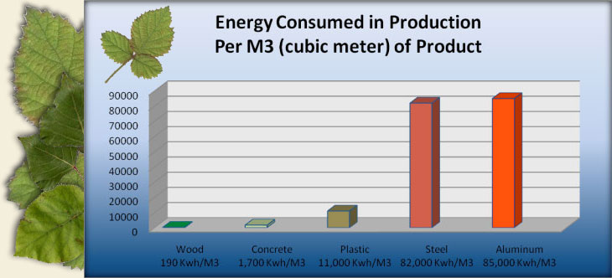
Environmental effects
What is this graph saying?
Is it responsible to have a colorbond fence instead of a timber fence?
Is it responsible to make aircraft out of timber?
Effects of the timber industry on the Environment

