Slide 1
Industrial Technology Timber Stage 5
General Wood - Core Module 2
Workplace Communication Skills

Slide 2
Students learn about: Workplace Communication Skills | Students learn about: (refer to Outcomes 5.4.1, 5.5.1 )
• orthogonal drawing • industry terminology • report writing (including the preparation of documentation to support the development and production of practical projects) | • interpret and produce orthogonal drawings related to the development and production of practical projects • identify and recall specialist terms and use them in context • write reports to document the development of practical projects, identifying the materials, processes and equipment used

Slide 3
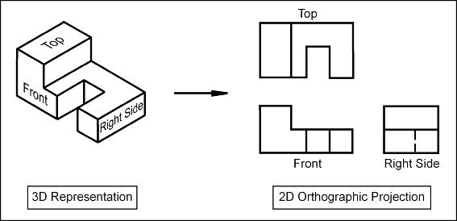
Orthogonal Drawings
An Orthographic projection is a 2-D representation of a 3-D object. The 2-D drawing represents different sides of an object.

Slide 4
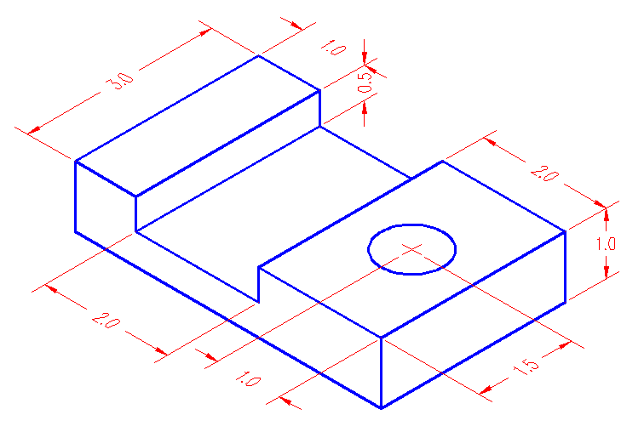
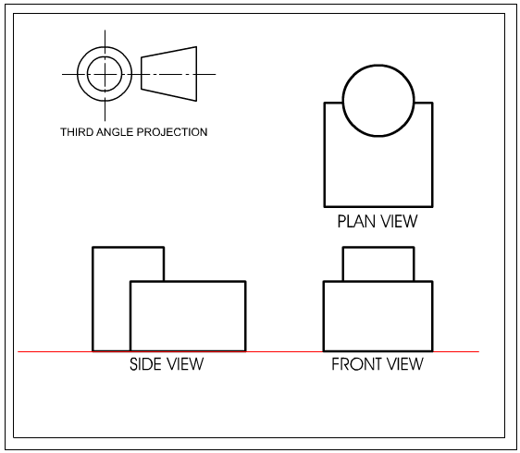
Orthogonal Drawings
Draw Orthographic views of this 3D object.
Draw a 3D view from this Orthographic drawing.

Slide 5
Industry Terminology
Write the meaning of each word:
DAR or RS (refers to the dressing of timber)
mm
PPE
Seasoning
Timber conversion
WHS
Aesthetics
Sustainability
CAD, CAM, ICT
Annotations
Identify and recall specialist terms in context

Slide 6
Report Writing
When writing a report on any project you construct in Industrial Technology you are required to write a Portfolio also. Topics may include:
Design, Management and Communication
Application of design principles in the production of the Major Project:
– design development
– sketching and idea generation
– prototyping, modelling and testing
– production and working drawings
– quality and ongoing evaluation
– selection of appropriate materials, processes and other resources
Development of practical projects
Identify materials, processes and equipment used.

Slide 7
Report Writing
Continued
Application of management and communication skills to produce a related folio justifying:
– research
– design
– analysis
– evaluation including selection of appropriate materials, components, processes and technologies
– ICT
– WHS
– presentation
Development of practical projects
Identify materials, processes and equipment used.

Slide 8
Report Writing
Continued
Production
Applying knowledge and skills through the construction of a Major Project which reflects:
– quality
– evidence of a range of skills
– degree of difficulty
– links between planning and production
– use of appropriate materials, components, processes and technologies
– evidence of practical problem solving
– WHS and safe work practices
Development of practical projects
Identify materials, processes and equipment used.

