Slide 1
Industrial Technology
Industry Study – Personnel Issues

Slide 2
This presentation covers…
Industrial relations
Entry level training requirements
Roles of industry personnel
thactindech.weebly.com

Slide 3
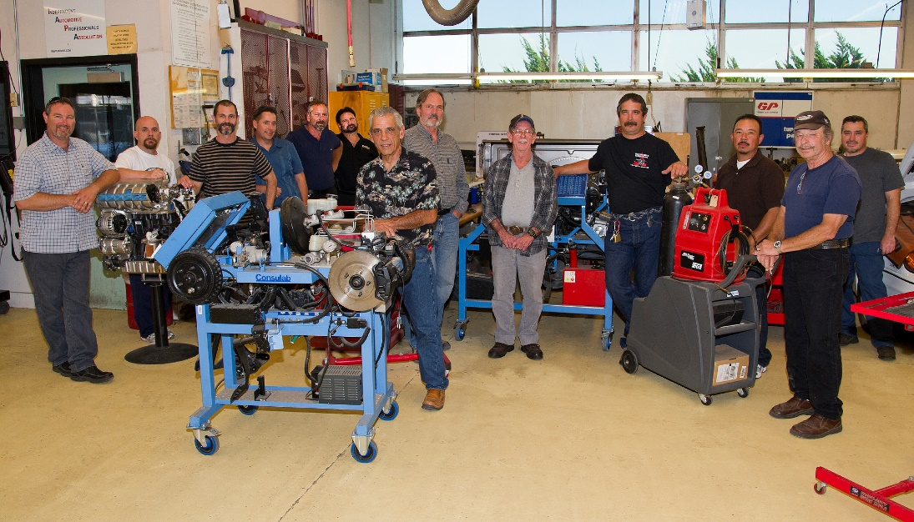
Industrial relations
Some companies have incentive schemes for employers.
Companies encourage workers who put greater effort in and some even can be rewarded.
Disputes are discussed and resolved on site with workers and management.
Can you think of a person at Thomas Hassall that can help with student conflict?

Slide 4
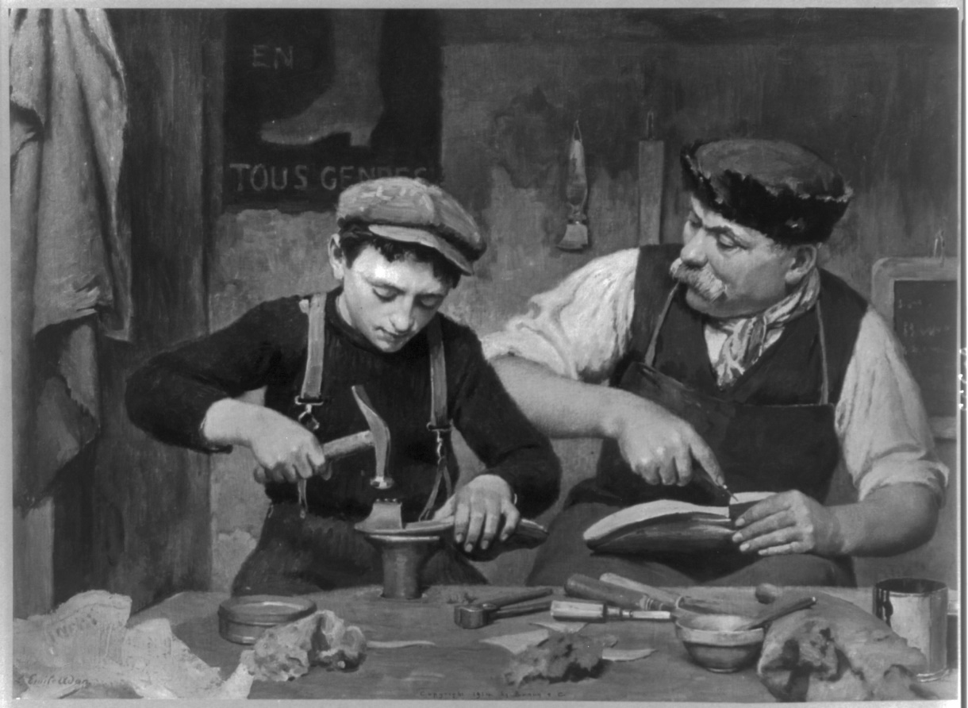
Entry level training requirements
All trade people need a qualification through TAFE.
Technical and Further Education (TAFE).
Usually 3 year one day a week at TAFE, and 1 year full time with the company.
Traineeships are also available over a two year period.
Some companies will provide a scholarship for a student and pay for their training.

Slide 5
Roles of industry personnel
There are many positions a person can have in a company, depending on the size.
Sales representative, purchasing officer, accounts clerk, carpenter, joiner, executive manager and many more.
All present and future employees have equal opportunities despite gender, beliefs, race and social status.
EEO (Equal Employment Opportunity) ensures fair consideration for a job or other job related benefits such as staff training and development.

