Slide 1
Industrial Technology
Design – Information Communications Technologies

Slide 2
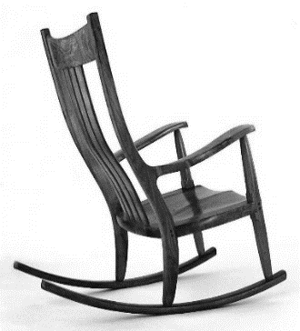
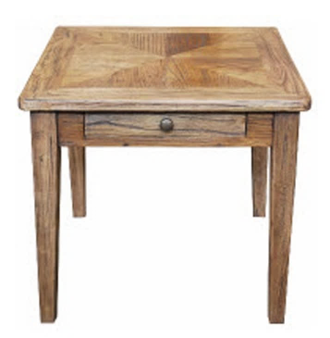
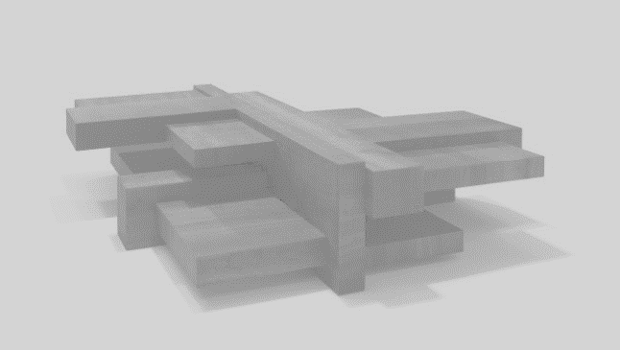
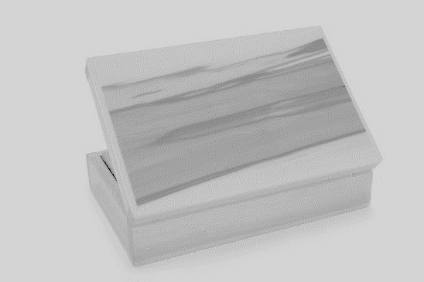
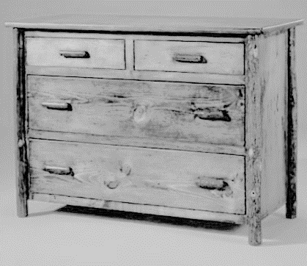
This is the topic we will be covering today
Industry Study
Design, Management and Communication
Production
Industry Related Manufacturing Technology
thacindtech.weebly.com
Industry Study
Design
Management and communication
Production
Industry Related Manufacturing Technologies

Slide 3
This presentation covers…
Word processing
Spreadsheets
Data bases
Presentation
Page layout
Computer-aided design (CAD)
thactindech.weebly.com

Slide 4
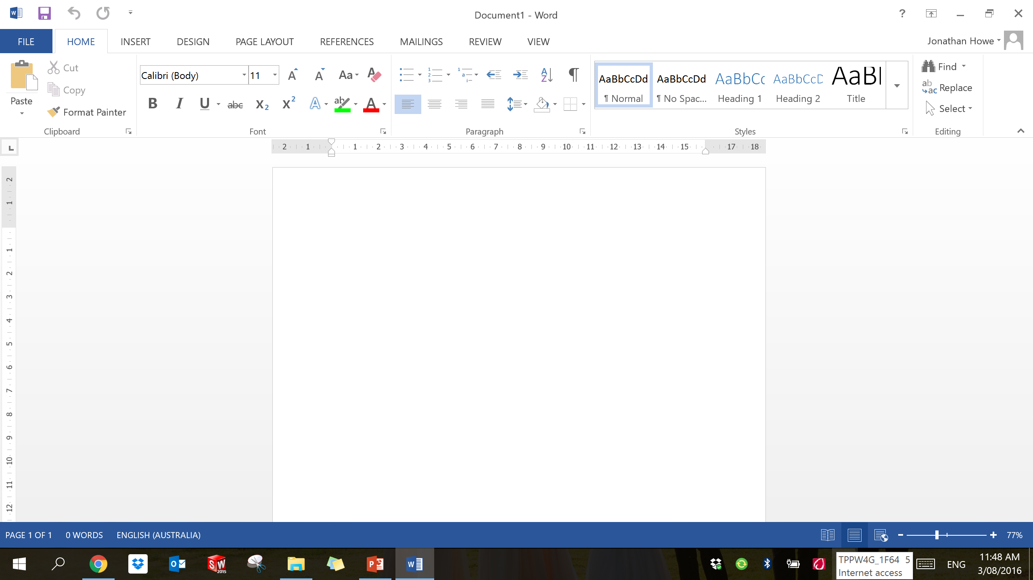
Word processing
Production, storage and manipulation of text on a computer.
Editing, formatting and printing can all be done through these programs.

Slide 5
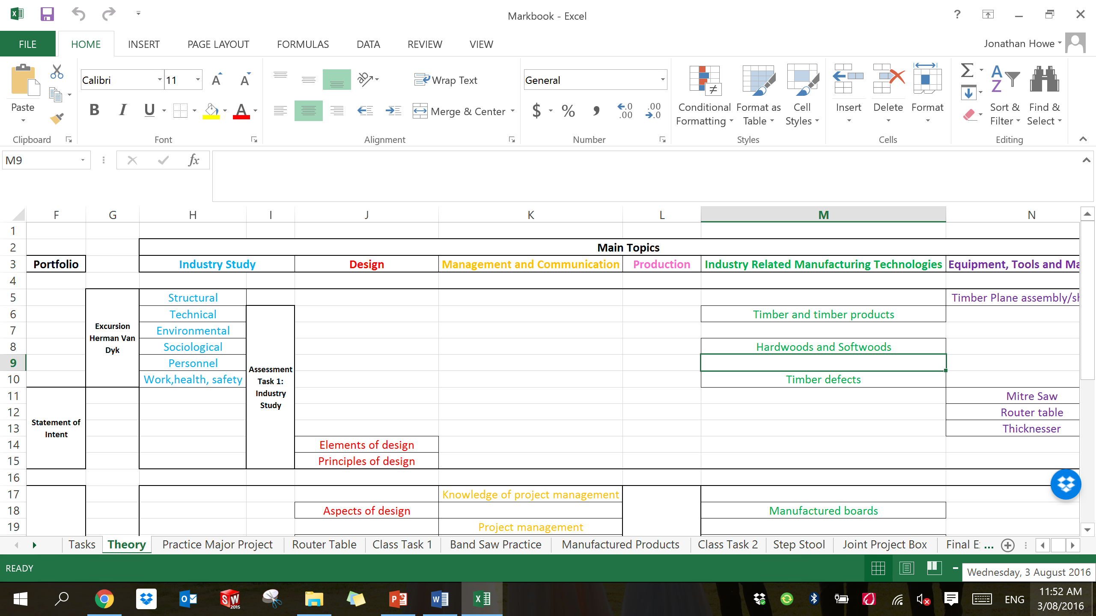
Spreadsheets
Spreadsheets are used for organisation, analysis and storage of data in table form.
Data is entered into cells of a table.
Formulas can be automatically calculated to form results and predictions.

Slide 6
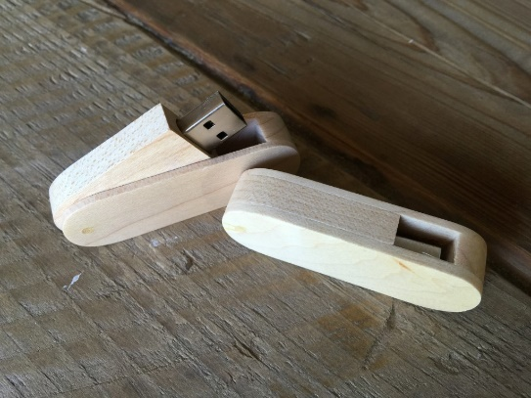
Data bases
An organised collection of data.
Tables, views and reports can be viewed on these programs.
Data is organised into models that supports processes requiring information.
For example modelling a program to find the availability of finding a hotel room.
A database supports people finding a hotel for a room vacancy.
USB and iCloud can be types of databases.

Slide 7
Presentation
Presenting information through a lecture or speech to inform and persuade the audience.
Often used to present content in a professional manner.
Prezi, power point are some programs used to be interactive with the audience in order to engage them.

Slide 8
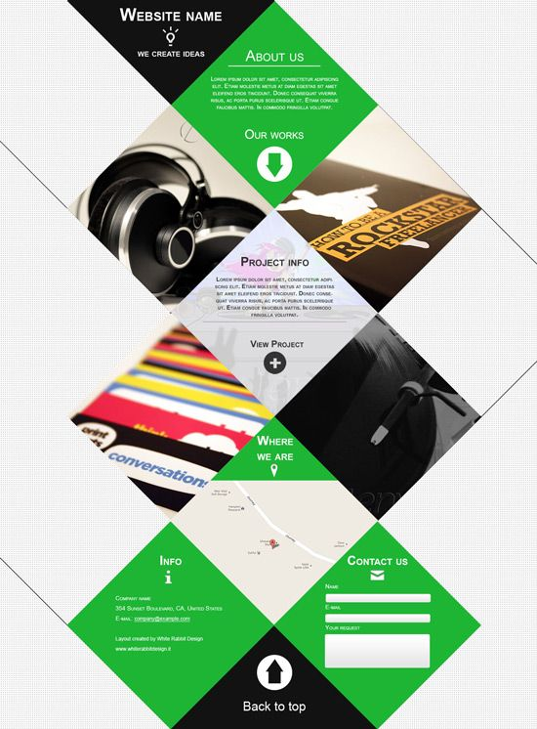
Page layout
Graphic design.
The arrangement of visual elements, and text on a page.
Your Major Project portfolio.
You need to now what your objective I before you graphically organise your elements and text.
Book, internet page, portfolio document, essay many different page layout types to choose.
Remember your customer or the person who will read this layout.

Slide 9
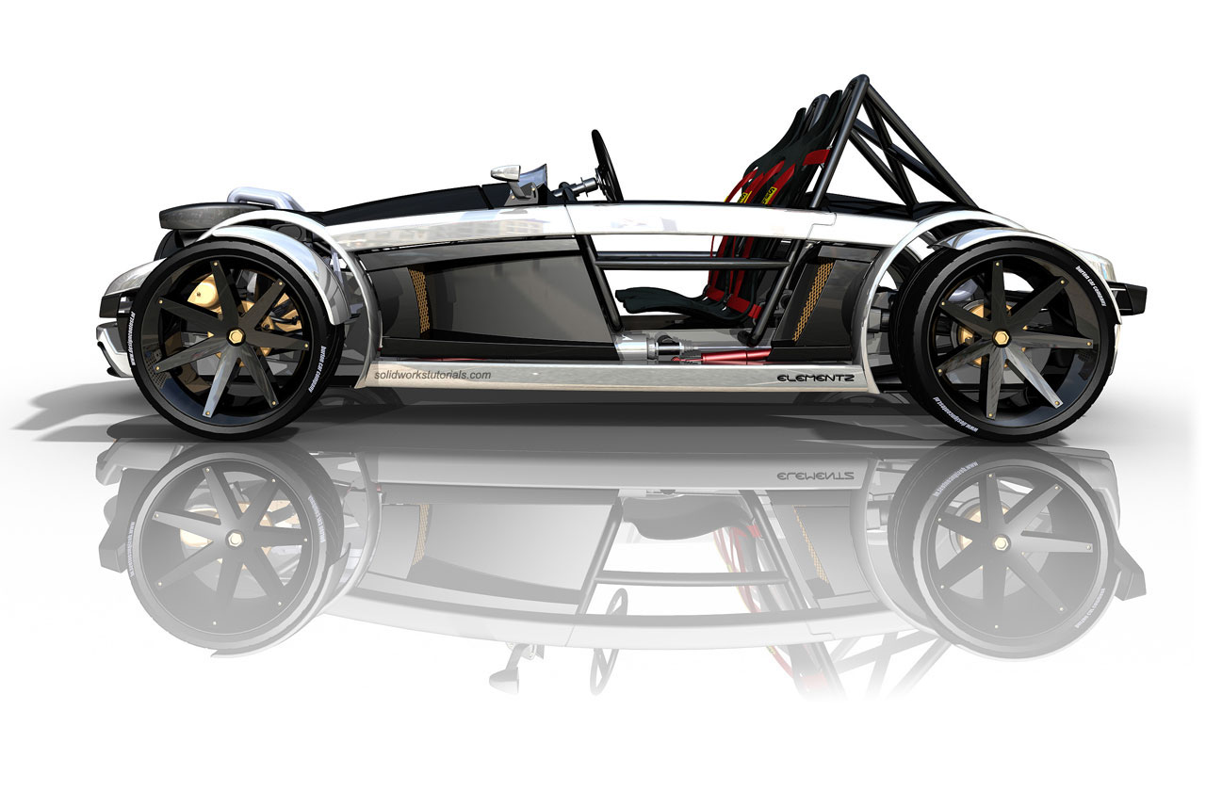
Computer-aided design (CAD)
Google sketch-up.
Solidworks.
AutoCAD.
These are some of many 3D modelling programs.
Programs today can do any type of drawings from sketching to final renderings.
They are used to communicate a project for business or personal use.

