Slide 1
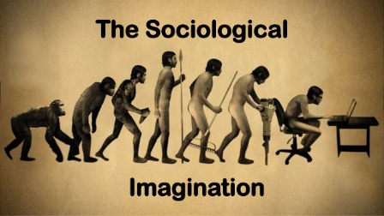
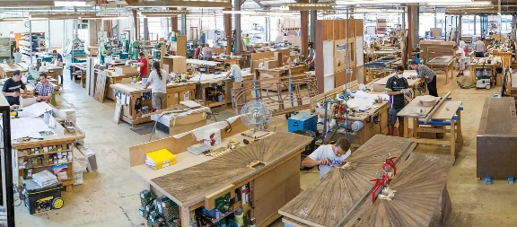
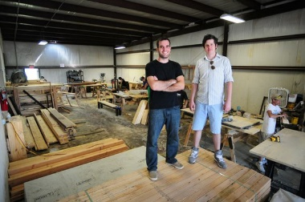
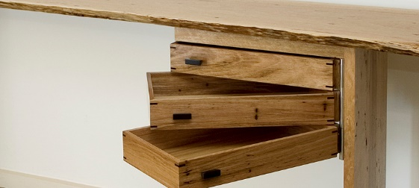
Industrial Technology
Industry Study – Sociological Factors

Slide 2
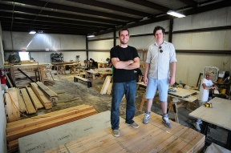
This presentation covers…
Issues relating to a business
Workplace cultures
The role of a business in the focus industry
thactindech.weebly.com

Slide 3
Issues relating to a business
Furniture companies provide employment for stimulating the local economy.
Business can also provide financial support for schools charities and sporting clubs through sponsorship or donations.
Companies can support Australian businesses by buying their product.

Slide 4
Workplace cultures
Happy and safe workplaces are essential.
Management should encourage positive work ethics.
Clear and concise communication is vital.
Fair and equal treatment of all employees is important.

Slide 5
The role of a business in the focus industry
Many furniture/housing companies will be members of Housing Industry Association (HIA).
Including the Furniture Industry Association of Australia (FIAA).
Though these bodies including trade shows, directors are constantly up-dated on new technologies related to their industry.
Why do you think organisations like this are around?

