Slide 1
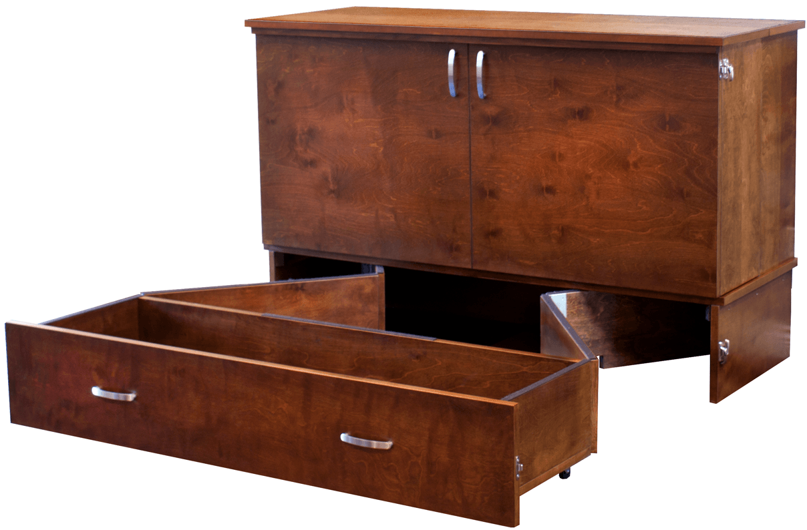
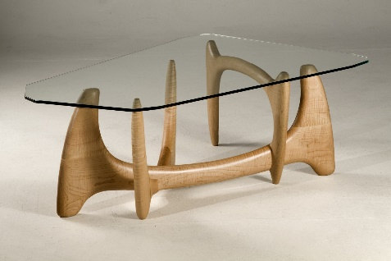
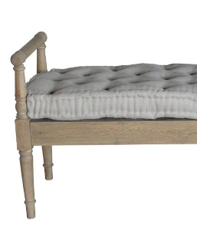
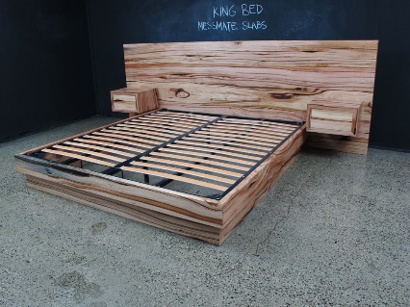
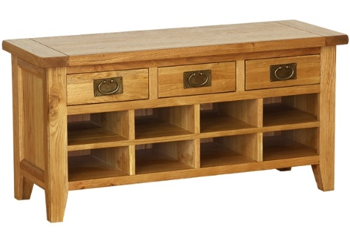
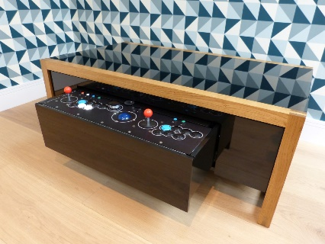
Industrial Technology
Design – Communication Techniques: Graphical

Slide 2
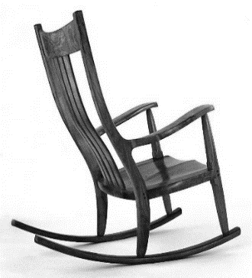
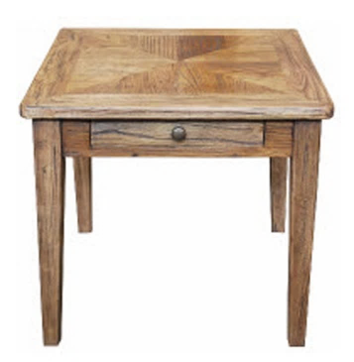
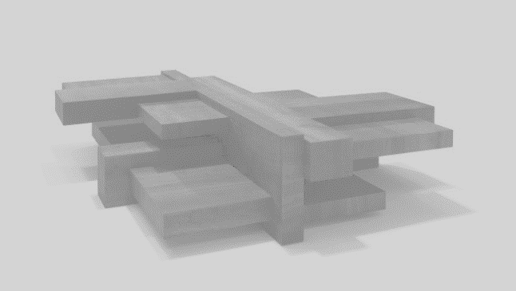
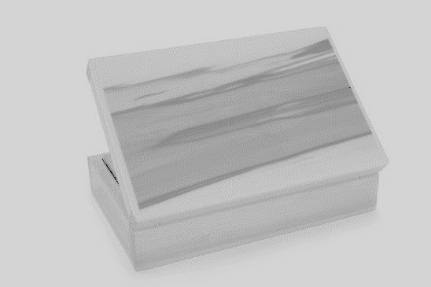
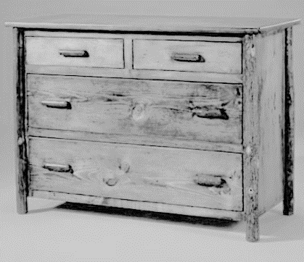
This is the topic we will be covering today
Industry Study
Design, Management and Communication
Production
Industry Related Manufacturing Technology
thacindtech.weebly.com
Industry Study
Design
Management and communication
Production
Industry Related Manufacturing Technologies

Slide 3
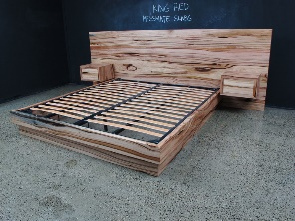
This presentation covers…
Object drawing
Sketching
Industry production drawing specifications
CAD and presentation techniques
thactindech.weebly.com

Slide 4
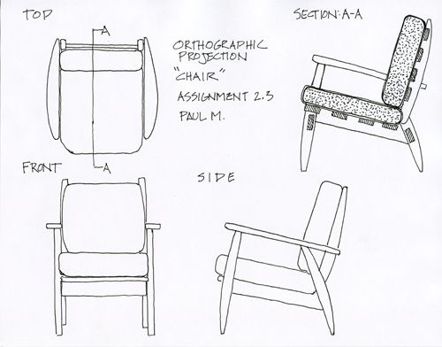
Object drawing
Different views from different perspectives of you projects design.
Orthogonal drawings with dimensions, 2D.
Pictorial drawings, isometric, perspective, 3D.
These drawings will give a story of what you intend to make, how you will make it and what the finished project will look like.

Slide 5
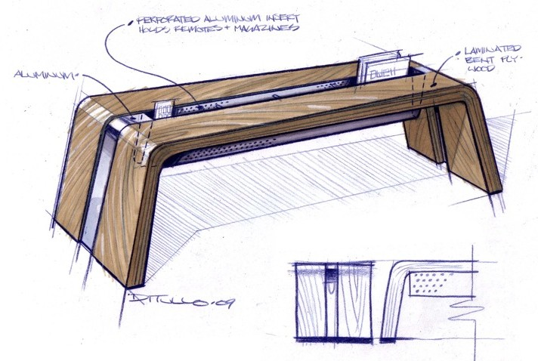
Sketching
Sketching is important to work out shapes and sizes of your project.
Use pencils to sketch drawings and use annotations to give the reader a picture of direction you want.
For final drawings use a pen or darker pencil lines and don’t forget to use annotations.
You can use any application or program that sketches.
Example: google sketch-up for quick 3D models.

Slide 6
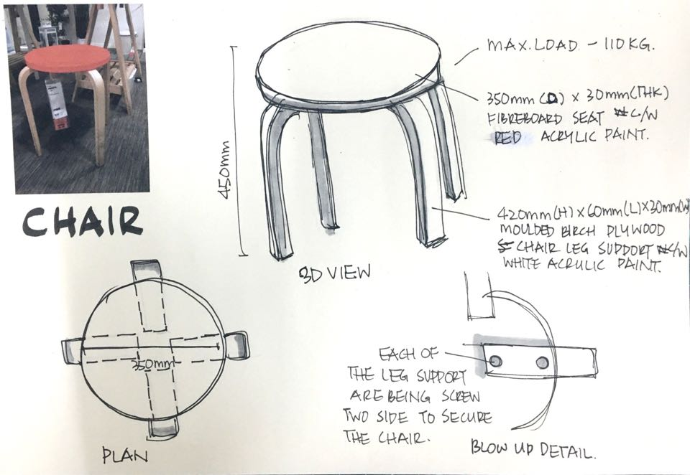
Industry production drawing specifications
Check dimensions are correct, this is what drawings are for to check before making.
Proportions can be checked with drawings especially in 3D views.
Accurate details make for less work manufacturing your project.
Exploded views can help with viewing hidden details that need to be seen to build your project.

Slide 7
CAD and presentation techniques
Google sketch-up.
Solidworks.
AutoCAD.
These are some of many 3D modelling programs.
Programs today can do any type of drawings from sketching to final renderings.

Slide 8
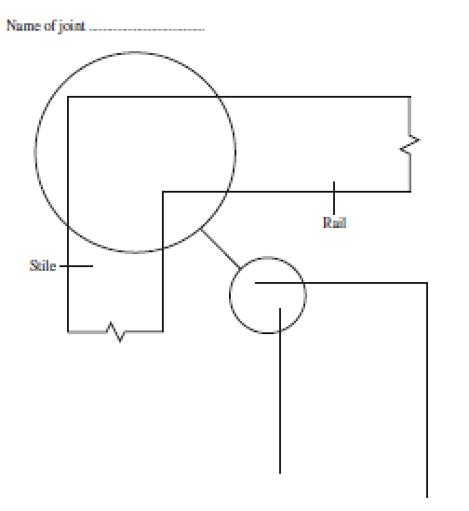
Past paper question related to safety
HSC Paper 2014
Question 13
The doors of a cupboard are made from solid timber.
Name and sketch a suitable joint to join the rail and stile as shown.
3 marks
Short Answer question
Please attempt this question…

