Slide 1
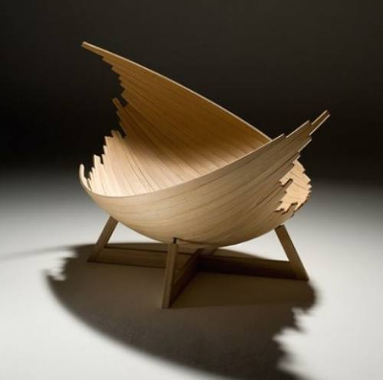
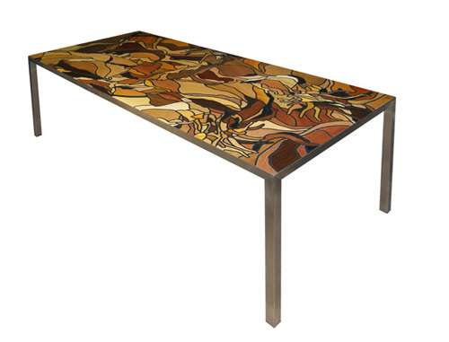
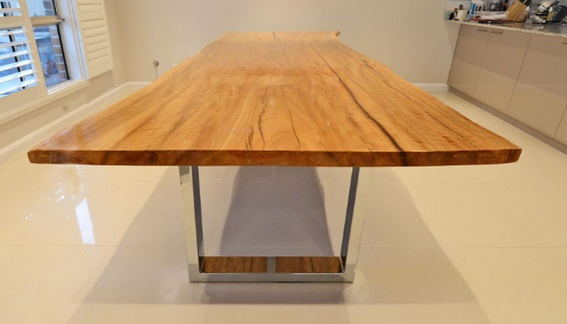
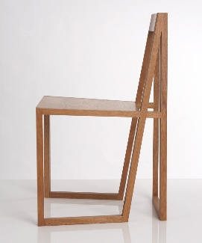
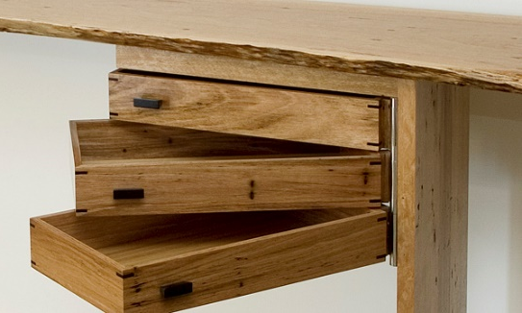
Industrial Technology
Management and Communication – Literacy

Slide 2
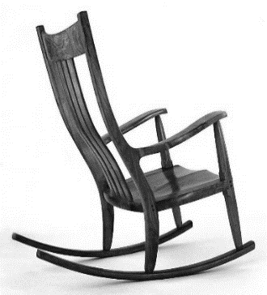
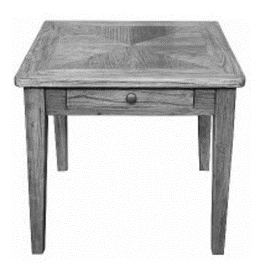
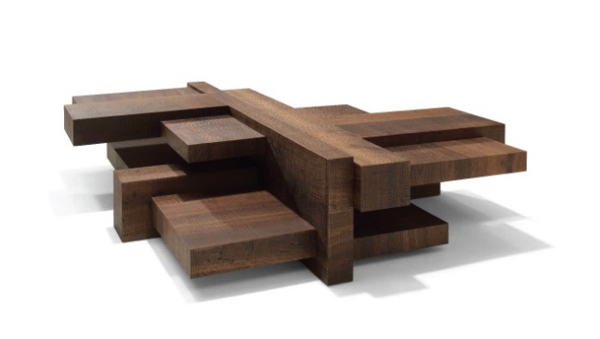
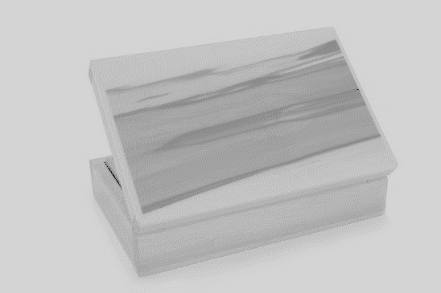
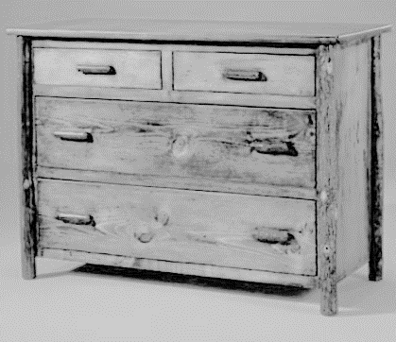
This is the topic we will be covering today
Industry Study
Design, Management and Communication
Production
Industry Related Manufacturing Technology
thacindtech.weebly.com
Industry Study
Design
Management and communication
Production
Industry Related Manufacturing Technologies

Slide 3
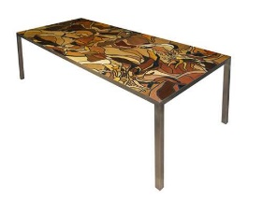
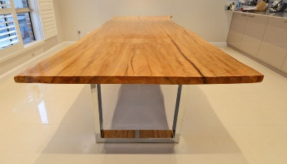
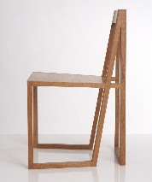
This presentation covers…
Industry terminology
Written reports using appropriate text types
Material/component list
Management folio
ICT
thactindech.weebly.com

Slide 4
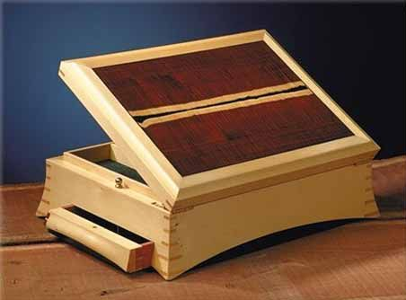
Industry terminology
Use the terms from the focus area which is furniture industry.
Literacy refers to the skills of reading and writing.
You must demonstrate literacy skills in the development of your portfolio.
You need to record all ideas with brief notes about features and problems you come across.

Slide 5
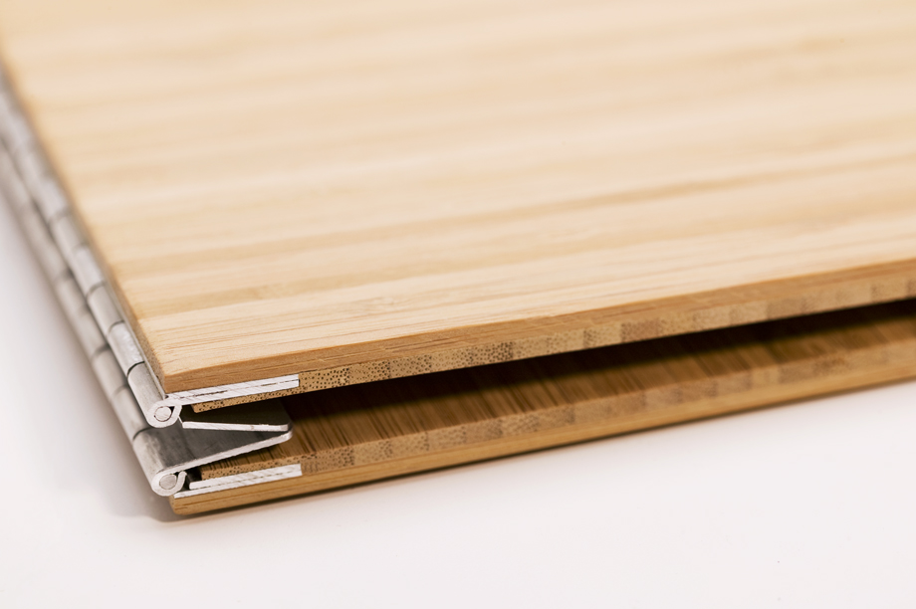
Textbook Resources
For correct terminology use the provided textbooks we have at college
1. Collins complete woodworkers manual by
Jackson and Day
2. Stage 6 Industrial Technology
Rochford
3. Furnishing
Schlyder
4. Woodworking Part Two
Leadbeatter and Leadbetter

Slide 6
Written reports using appropriate text types
Major Heading
Minor Heading
Sub heading
Major Heading
Minor Heading
Sub heading
Refers to the language and structure of the written document.
Keep a consistent theme throughout the portfolio.
Major, minor and sub headings need to be used, keep these consistent throughout the portfolio.
Major Heading
Minor Heading
Sub heading
Major Heading
Minor Heading
Sub heading

Slide 7
Material/component list
The selection of materials.
The justification of materials.
Presentation of materials.
All displayed in a report or your portfolio.
Make sure you include evaluation.

Slide 8
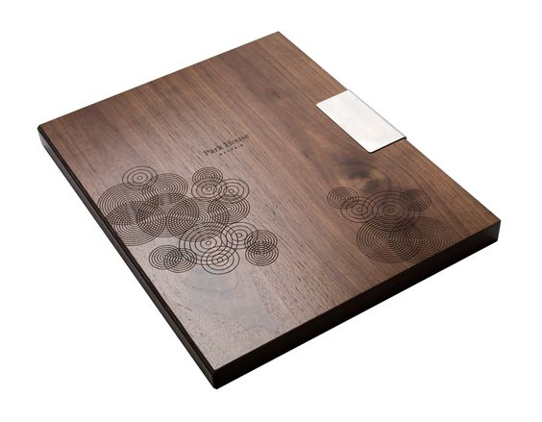
Management folio
Have someone other than your teacher to keep you accountable to monitor the progress of your portfolio.
Keep your A3 diary on you all the time during practical lessons.
When you sketch or use pictures make sure you annotate them.
Keep a consistent theme throughout your portfolio for example… if you use a border for pictures keep that consistent through the whole document.

Slide 9
ICT
Please refer to ICT PP from our design topic
Word processing covering these ICT’s:
Spreadsheets
Data bases
Presentation
Page layout
Computer-aided design (CAD)

