Slide 1
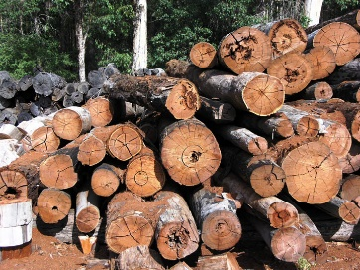
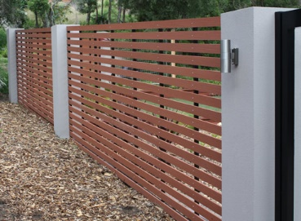
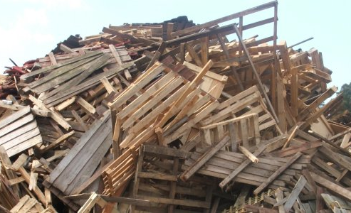
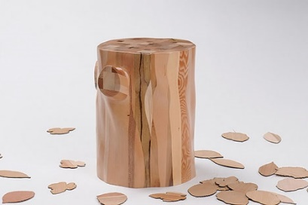
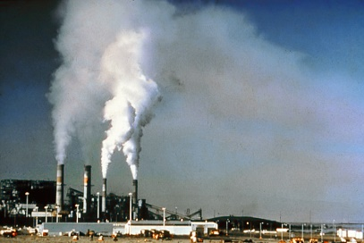
Industrial Technology
Industry Study – Environmental Factors

Slide 2
This presentation covers…
Resources
Alternatives and considerations
Recycling and reusing
Pollution
Government legislation
thactindech.weebly.com

Slide 3
Resources
What resources/timber does the company use for their main products?
Each company will use one or several resources/timbers on a regular basis.
They will have a company that supplies the resources at a fixed pricing.
Other companies always come into the business and try and sell their resource as better than the one they are currently using.
Most companies will stay loyal to their supplier.
Like a brand of car that your family always buy.

Slide 4
Alternatives and considerations
Alternatives are always an option for using other resources/timbers.
MDF is a common timber because it is cheap and easy to work with.
Using an alternative timber requires more cost, tooling changes to cope with the different timber type.
This would be a uneconomical process and would not serve the company well.

Slide 5
Recycling and reusing
Recycling is important and most companies do not recycle or reuse timber off cuts.
Many companies see it as a waste of time.
Timber scraps are taken to local landfill sites and disposed of accordingly.
Usually most companies will recycle paper.

Slide 6
Pollution
Most furniture companies will have a dust extractor for getting rid of the saw dust created by machines.
An air filtration system will also be set up for cleaning the air from dust and timber particles.
Noise pollution needs to be addressed which most factories conceal noise from machinery.

Slide 7
Government legislation
Companies need operate under the Department of Environmental and Conservation regulations (DEC).
Environmental Protection Authority (EPA) ensures the protection of the environment from industrial operations.
Getting rid of toxic chemicals requires the company to dispose of these hazards according to the EPA.

