Slide 1
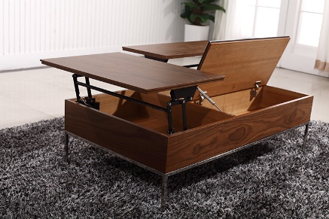
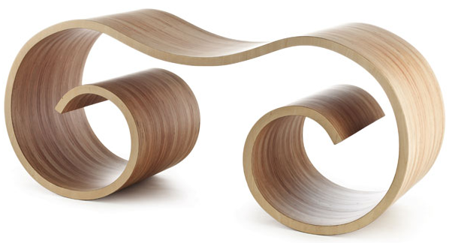
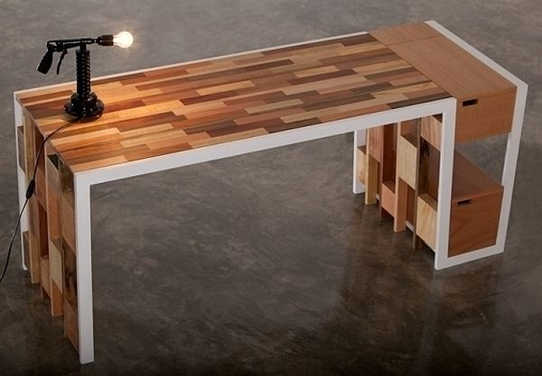
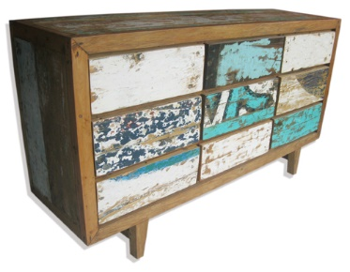
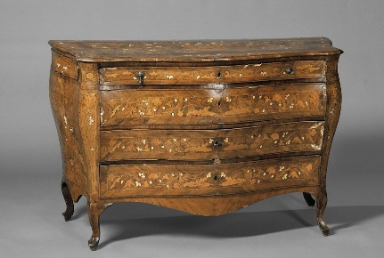
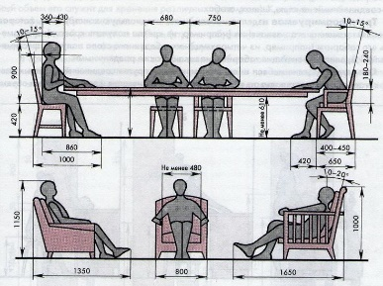
Industrial Technology
Design – Aspects of Design

Slide 2
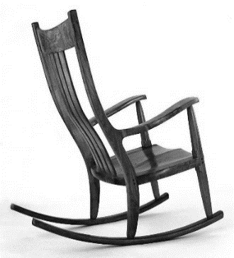
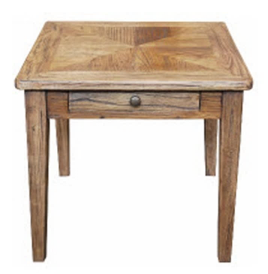
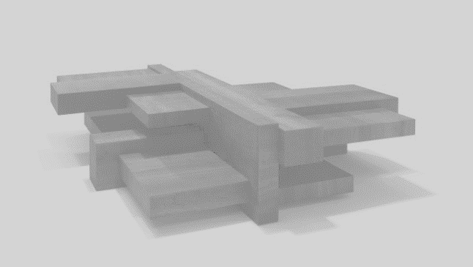
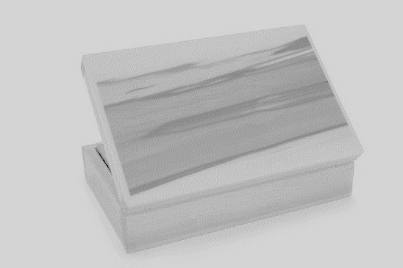
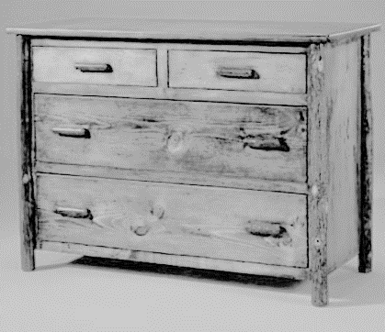
This is the topic we will be covering today
Industry Study
Design, Management and Communication
Production
Industry Related Manufacturing Technology
thacindtech.weebly.com
Industry Study
Design
Management and communication
Production
Industry Related Manufacturing Technologies

Slide 3
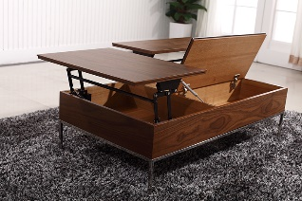
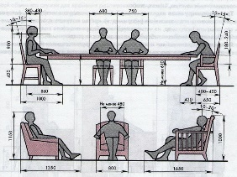
This presentation covers…
Functionality
Aesthetics
Economics
Environment
Manufacturing techniques
Sustainability
Decoration
Anthropometrics and ergonomics
Material suitability and selection
thactindech.weebly.com

Slide 4
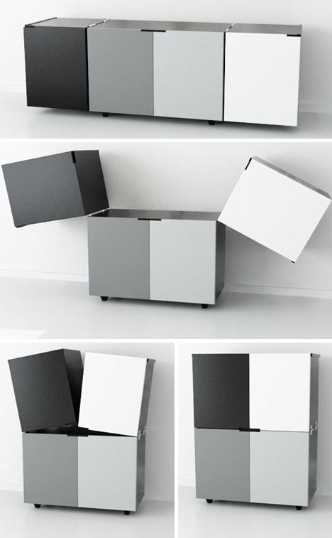
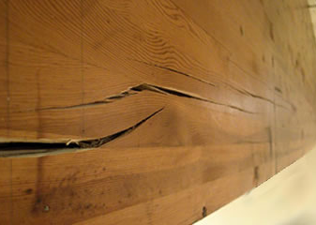
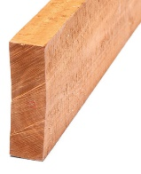
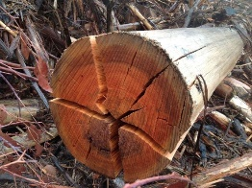
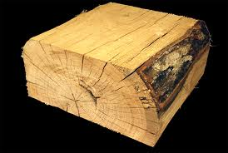
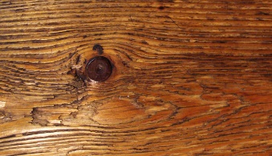
Functionality
Refers to how and whether it works for it's intended use.
Function can be assessed by examining safety features like the strength of the product.
Is it easy to use, are instruction clear to understand.

Slide 5
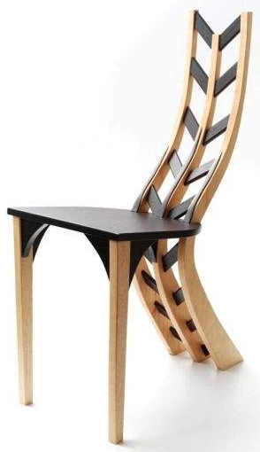
Aesthetics
Very important, refers to the overall appeal of the creation.
Aesthetics is determined by the arrangement and use of elements and principles of design.

Slide 6
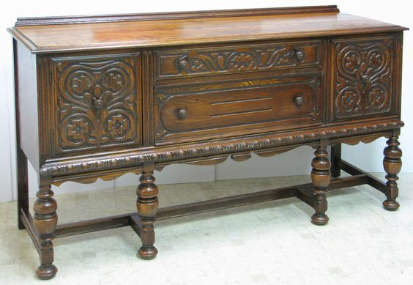
Economics
A budget is a necessary part of any project.
Expenditure refers to cost of items, tools, materials, manufacturing process, labour, energy and time.
Each project will need an estimated cost and an actual cost which will go into your portfolio.

Slide 7
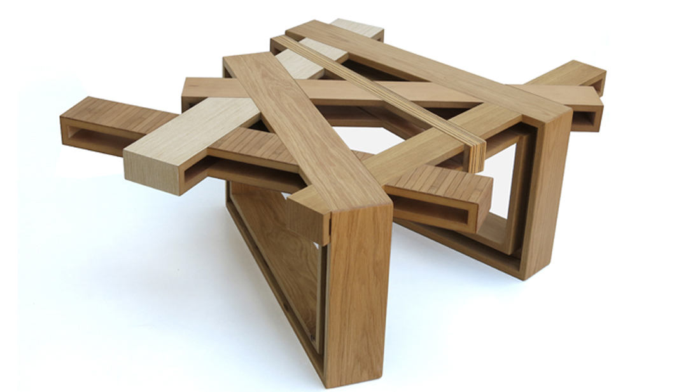
Environment
What type of environment will your project live in, bedroom, lounge room, kitchen…
Matching your environment is important for a successful project.
Do you know where your project will end up living…
Explain the importance of matching your project to your intended environment?

Slide 8
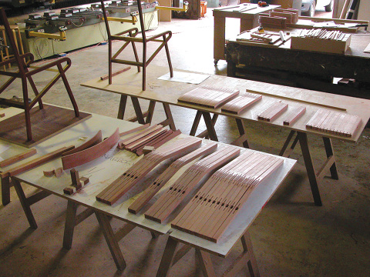
Manufacturing techniques
You need to know the manufacturing techniques you want to use for your project.
If you need to use the table router for a specific manufacturing technique, practice this before you attempt the part for your project.
You will keep a record of your manufacturing techniques in your portfolio.

Slide 9
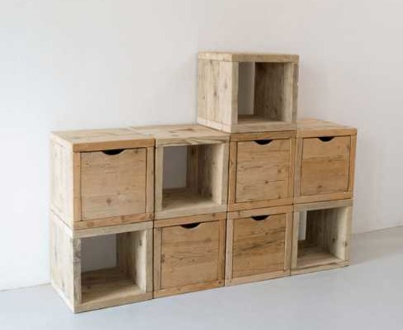
Sustainability
How will sustainability be used in your design?
What will be done with the off cuts of your timber?
How will this minimise your carbon footprint on the local community?

Slide 10
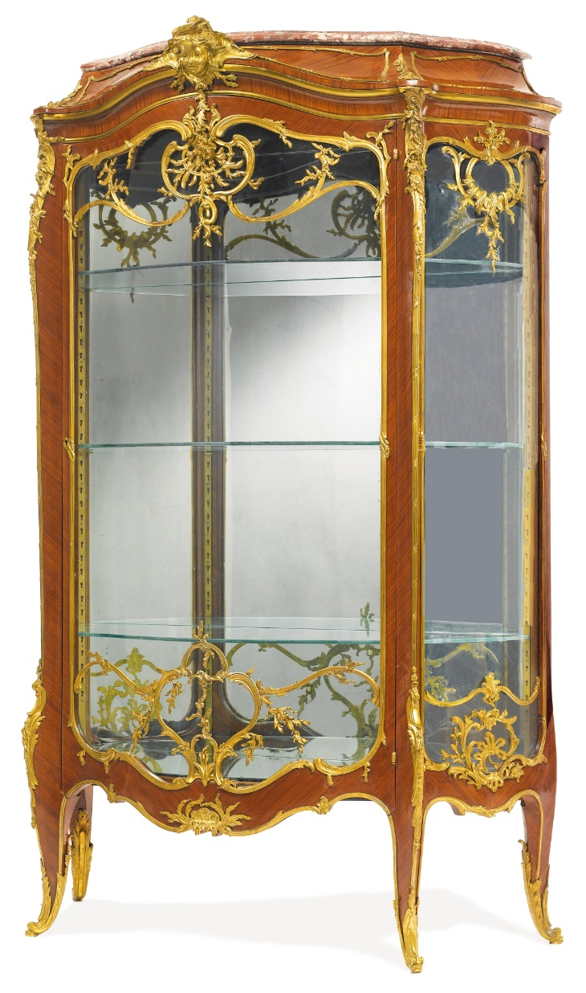
Decoration
Decoration is an important part of presenting a final piece of furniture.
It can refer to a simple chamfer on an edge of a table or TV cabinet door.
It can be as complex as inlaying another type of timber to have a feature stand out in your project.

Slide 11
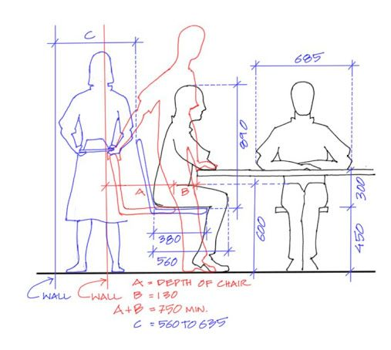
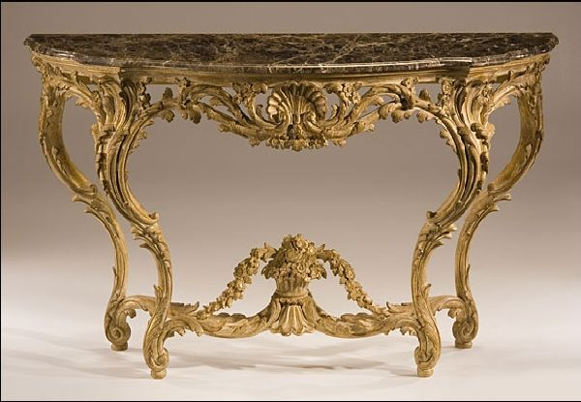
Anthropometrics and ergonomics
About fitting work to people.
Process of designing and arranging workplaces, products and systems so that they 'fit' the people who use them.
Anthropometry, which measures data from various body shapes and sizes.

Slide 12
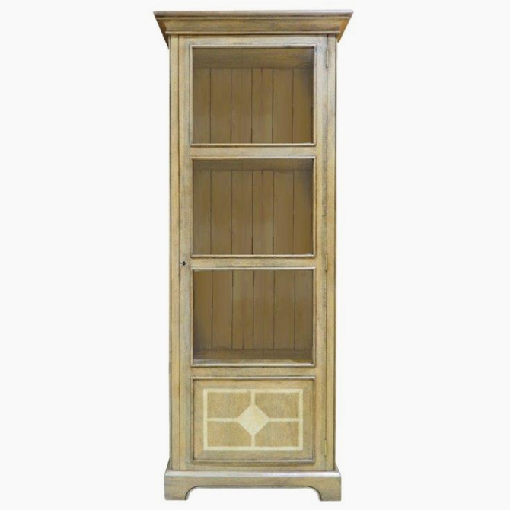
Material suitability and selection
The most important question is what material can I use in the size I need.
You will need to research this after the development of ideas section in your portfolio.
Be careful not to order an expensive piece of hardwood timber when it will never be seen in your project.
The bottom of a drawer or the back of a TV cabinet will usually not be seen.

