Slide 1
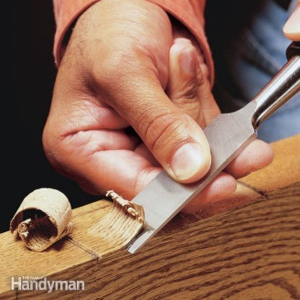
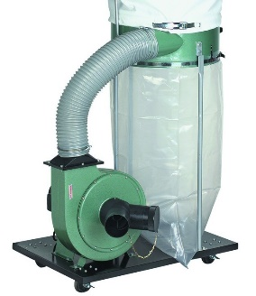
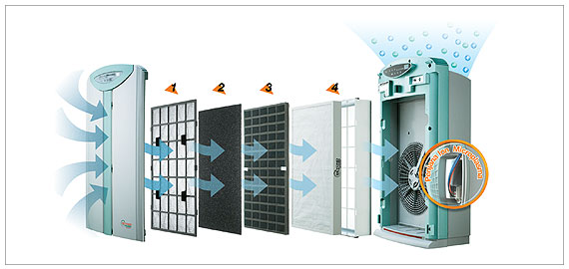
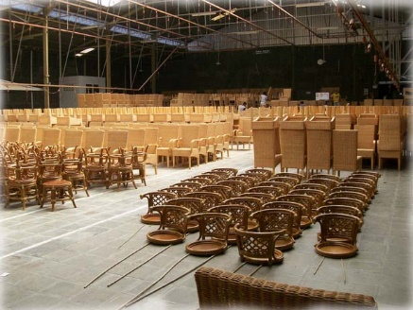
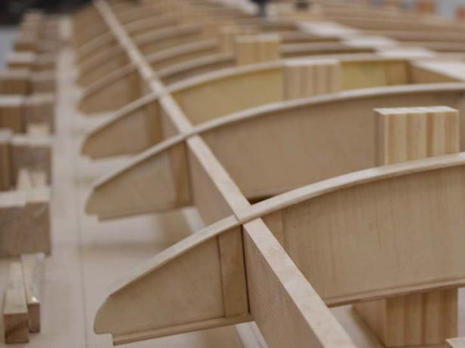
Industrial Technology
Industry Study – Environmental and Sociological Considerations

Slide 2
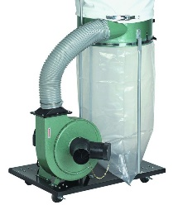
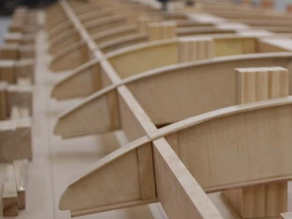
This presentation covers…
History of mass production
Mass production
Mechanisation
Specialisation
Automation
thactindech.weebly.com

Slide 3
History of mass production
Introduced by Henry Ford manufacturing the Model T Ford, introduced an assembly line on December 1st 1913.
High volume production of highly standardised product.
CNC machines allow for mass production in many companies around the world.
This process has become the norm, increasing the productivity rate of a product.

Slide 4
Mass production
High volume production of highly standardized product.
Together with job production and batch production, it is one of the three main production methods.
Involves making many copies of products, very quickly using an assembly line techniques.
Parts are sent to workers who each work on an individual step.
This is faster than having a worker make the project from start to finish.

Slide 5
Mechanisation
The process of replacing human muscle or animals to doing that specific process with machinery.
From hand tools to power tools.
From machines to CNC machines.
Less operation is needed by humans, however humans still need to operate and set up the machine.

Slide 6
Specialisation
In the past specialsation was used widely in industry. CNC machines and power tools have minimised this process.
When a workers skills and strength match their job.
Usually an experienced tradesmen would be given the responsibility of a specialist process.
Specialist processes take time to train a person in the procedure.
This can take year making the professional tradesman priceless.

Slide 7
Automation
Machines which replace human judgment and perception.
The use of various control systems for operating equipment like machinery, processes in factories, boiler and heat treating ovens and aircraft.
Largest benefit is that it saves labour, energy and materials, improves quality, accuracy and precision.
Automatic systems include mechanical, hydraulic, pneumatic, electrical, electronic devices and computers.

Slide 8
New and emerging technologies
Technologies that can possibly change the status quo.
Meaning change the way things are normally done.
Generally new technologies but include older technologies and undeveloped into a commercial setting, meaning making money for someone.
They are characterized by radical novelty, relatively fast growth, coherence, prominent impact and uncertainty.

