Slide 1
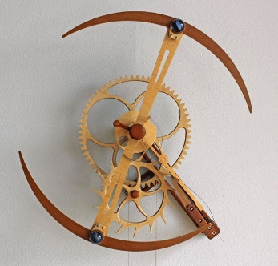
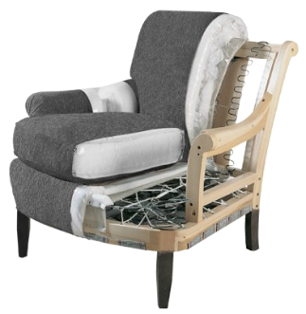
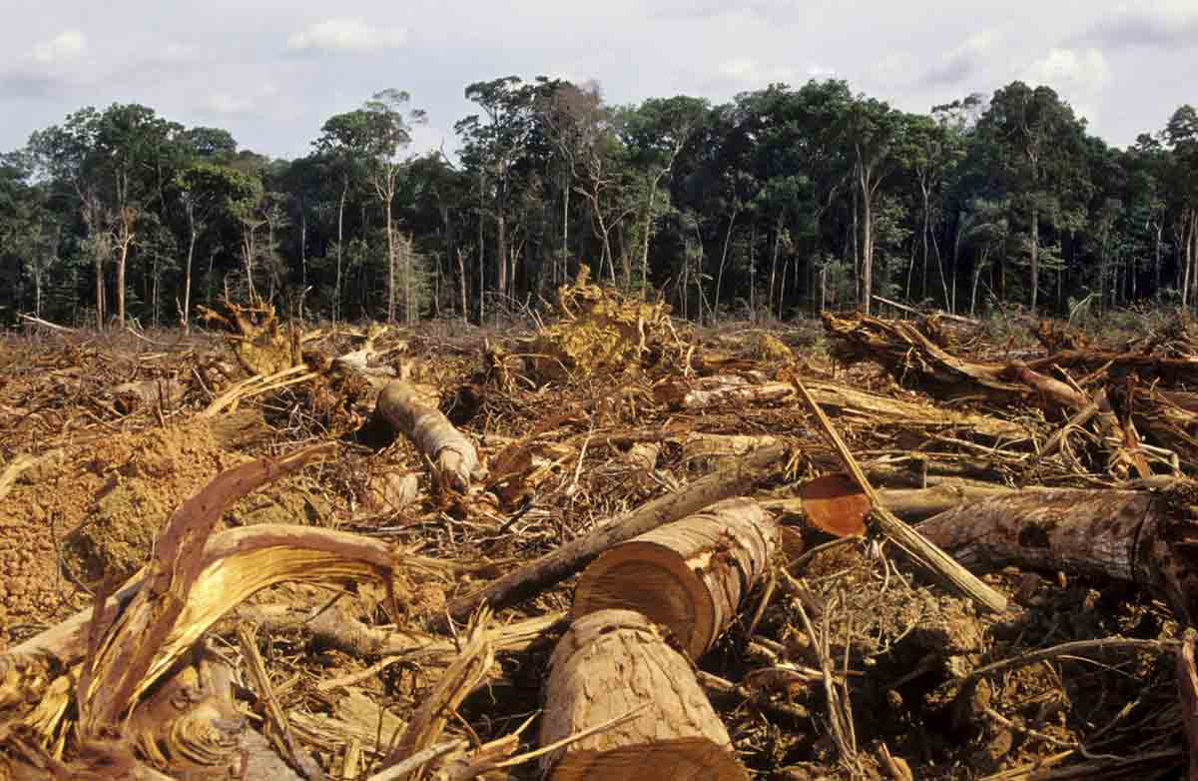
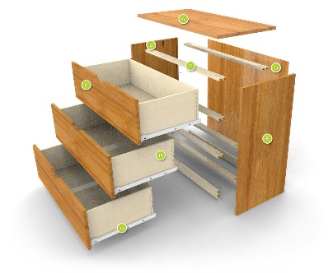
Industrial Technology
Management and Communication – Project Management

Slide 2
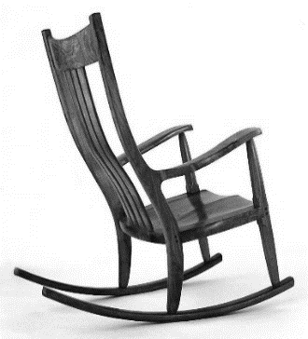
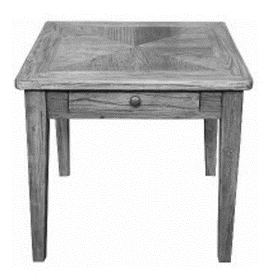
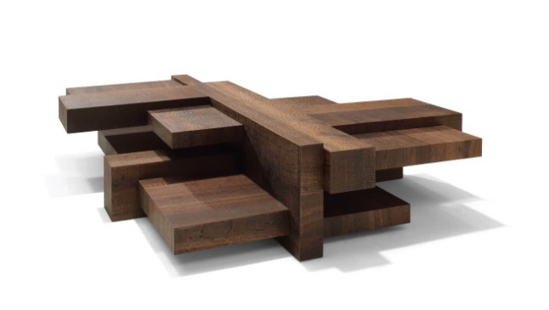
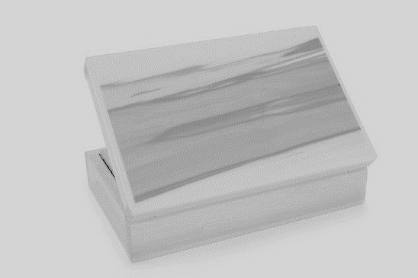
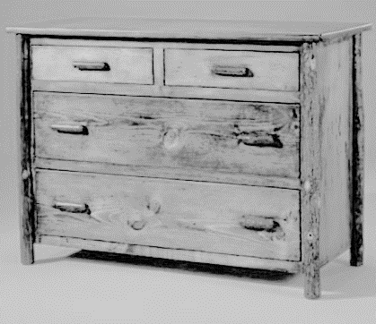
This is the topic we will be covering today
Industry Study
Design, Management and Communication
Production
Industry Related Manufacturing Technology
thacindtech.weebly.com
Industry Study
Design
Management and communication
Production
Industry Related Manufacturing Technologies

Slide 3
This presentation covers…
Planning
Time
Materials
Finance
Ethical issues
Construction of project
Documentation
thactindech.weebly.com

Slide 4
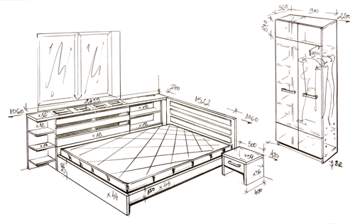
Planning
Planning your project is the most important aspect.
How will you gather your ideas.
What are you going to make, once you decide DO NOT CHANGE YOUR MIND!!
Keeping focused on work and using any spare time you have is vital to finish construction early.
Mistakes need to be recorded in your folio through ongoing evaluation.

Slide 5
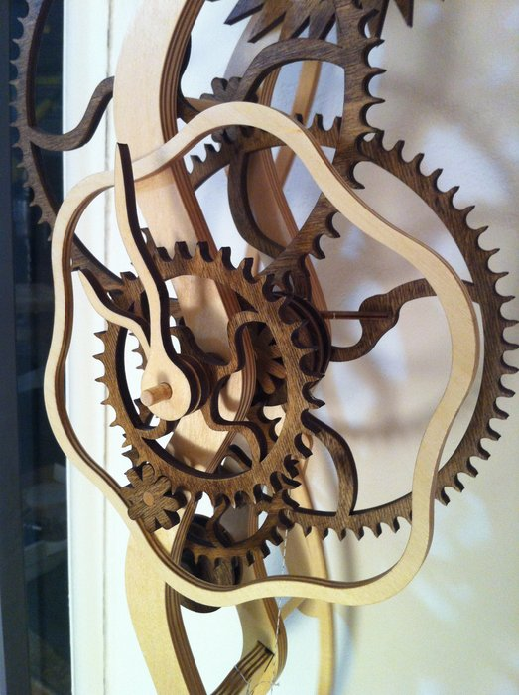
Planning Timing
The most important area to consider…
Develop a time plan for deciding what to make.
Excel spreadsheet can be good or a simple table on Microsoft word is fine.
Remember a proposed and actual time plan followed by an evaluation of this is expected.
Remember to plan your folio as well don’t leave this to the last minute.

Slide 6
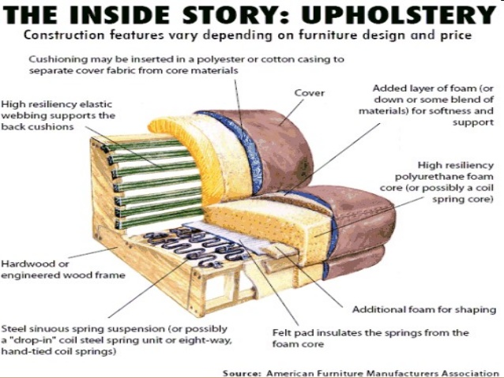
Planning Materials
Where will you get them from?
What are the characteristics of the materials?
MSDS for any materials used like PVA, polyurethane.
What quantity do you need of each material?
This needs to be planned before you order you materials.

Slide 7
Planning Finance
Where is the money coming from?
Do you have a budget or maximum price you can spend?
What areas of the project require finance?
What is your expected total for each item?
How much did you actually spend?

Slide 8
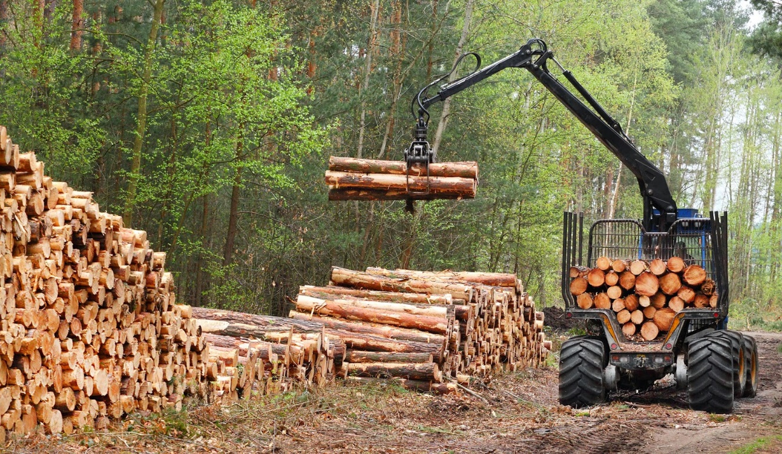
Planning Ethical
Make sure you do not copy another design exactly.
Will you be breaking any laws in the making of your project?
Don’t chop a tree down to make your project.

Slide 9
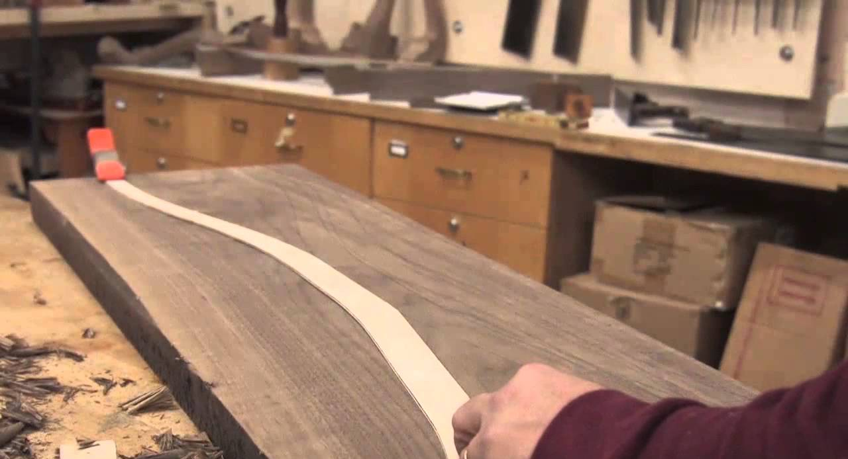
Planning Construction of project
What processes will you use?
Make a detailed step by step construction plan including all tools, machines and equipment needed.
Include correct names of processes and joints and don’t forget safety aspects needed.
A must is to include photos of you working…

Slide 10
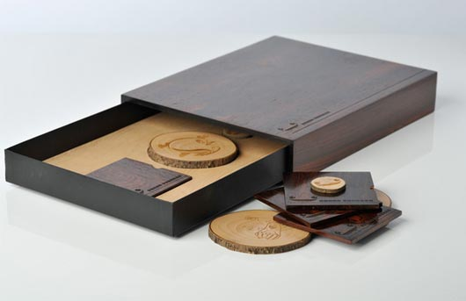
Documentation
Document all your work for your portfolio.
Keep an A3 diary of any sketches that you might make.
Save a back up copy of any files you create and keep them in a secure place.
Make sure your teacher checks all your portfolio work for minor or major edits.

