Slide 1
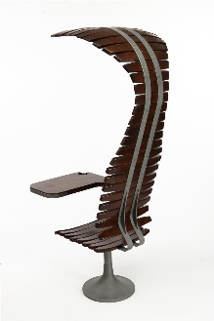
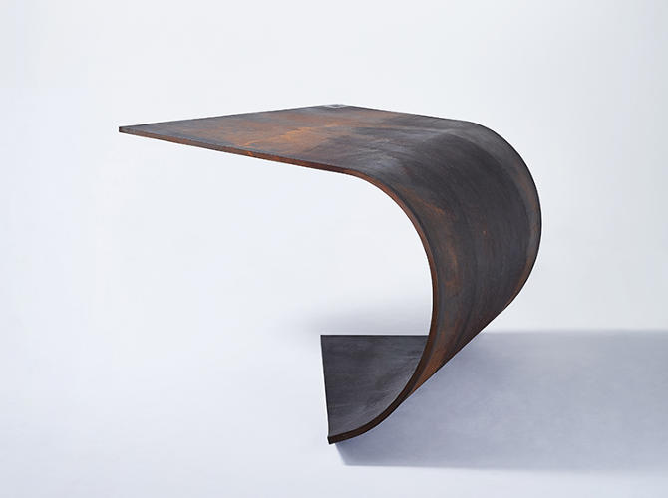
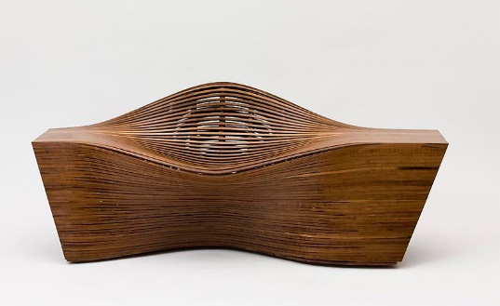
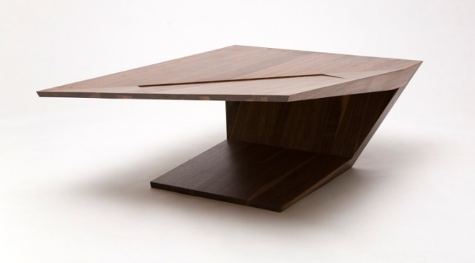
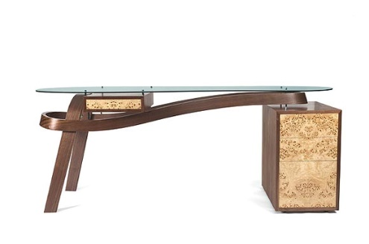
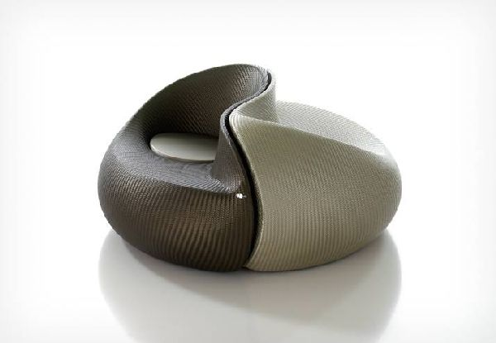
Industrial Technology
Design – Pricinples of Design

Slide 2
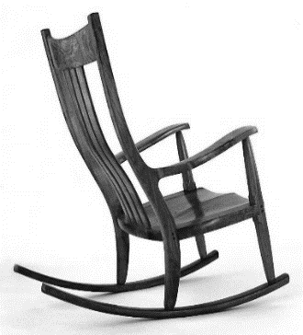
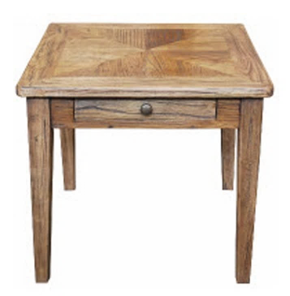
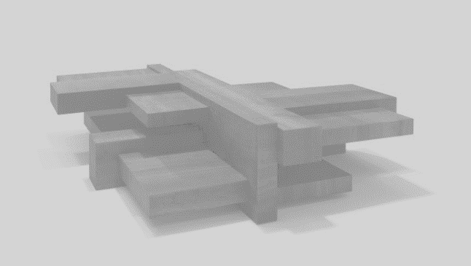
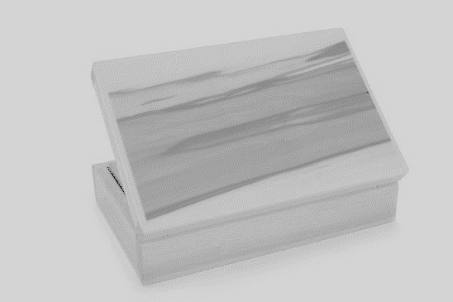
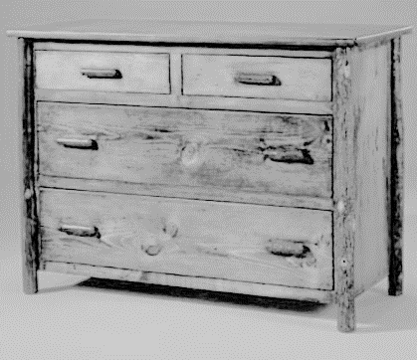
This is the topic we will be covering today
Industry Study
Design, Management and Communication
Production
Industry Related Manufacturing Technology
thacindtech.weebly.com
Industry Study
Design
Management and communication
Production
Industry Related Manufacturing Technologies

Slide 3
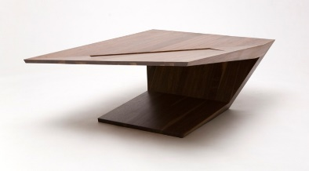
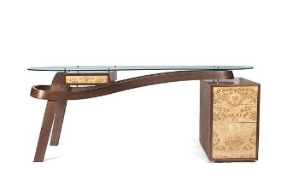
This presentation covers…
Proportion
The Golden Ratio
Balance
Rhythm
Emphasis
Contrast, harmony and unity
thactindech.weebly.com

Slide 4
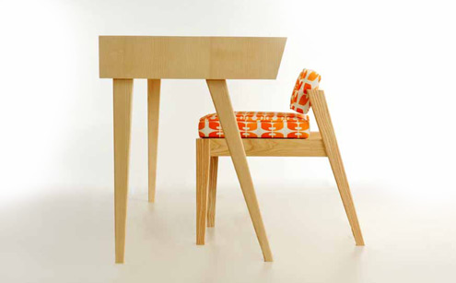
Proportion
Refers to the way all the parts of design relate to each other.
Individually and as a whole.
Shape, size, amount of parts are compared.
What is the golden ratio?

Slide 5
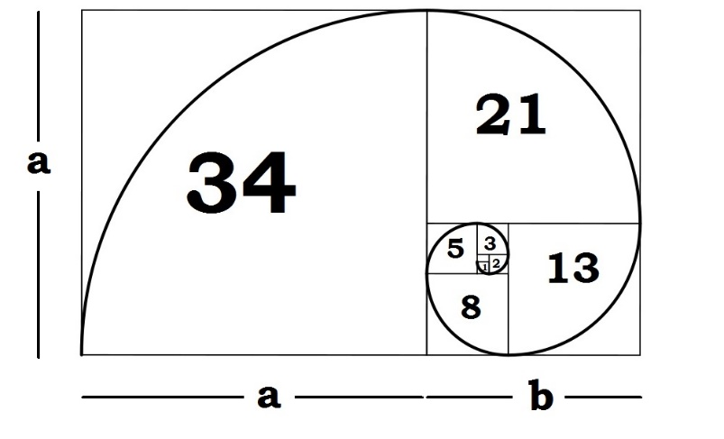
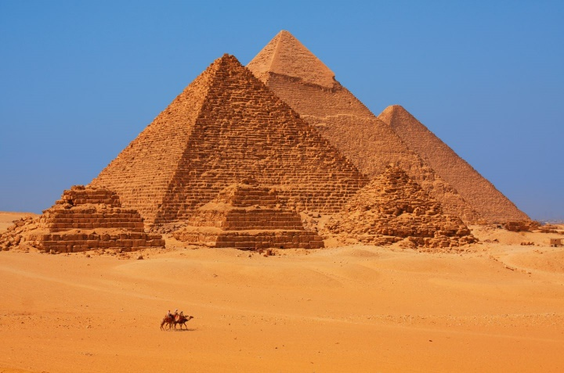
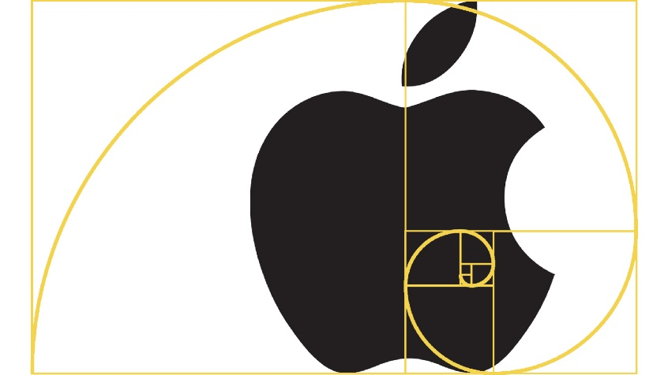
Golden Ratio
Many objects are designed using the golden ratio as a guide.
The golden ratio is approx. 1.6.
The pyramids use this the base being 756 feet with a height of 481 feet. The ratio of the base to the height is 1.5717.
Apple logo is designed using the golden ratio.
Measure something in the workshop and see if the ratio is similar to the golden one.

Slide 6
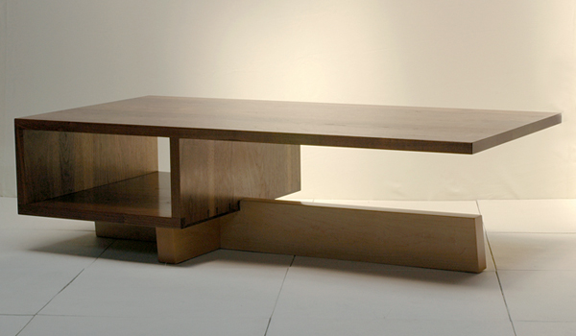
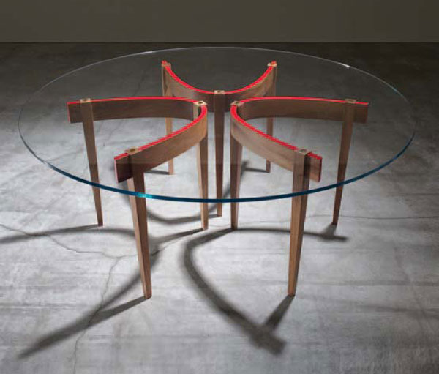
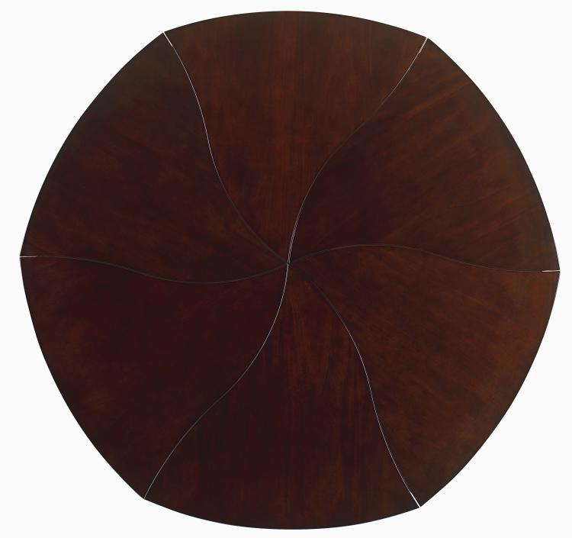
Balance
This occurs when the visual weights (shape, texture, colours, lines and spaces) of the design are equally balanced.
Three types of balance are symmetrical, asymmetrical and radial.

Slide 7
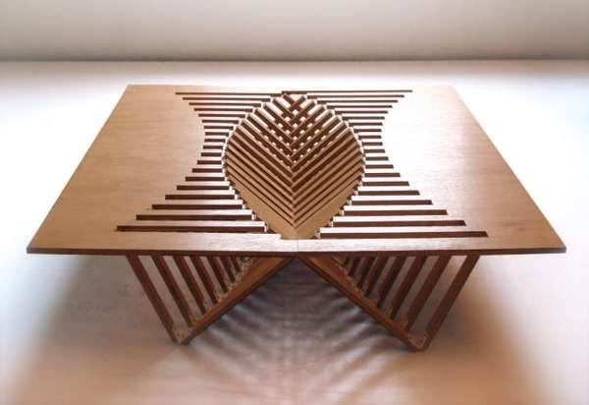
Rhythm
Organised movement.
A visual beat that stimulates the eye to move around the design.
Strong when line, shape, colour, and texture are repeated.

Slide 8
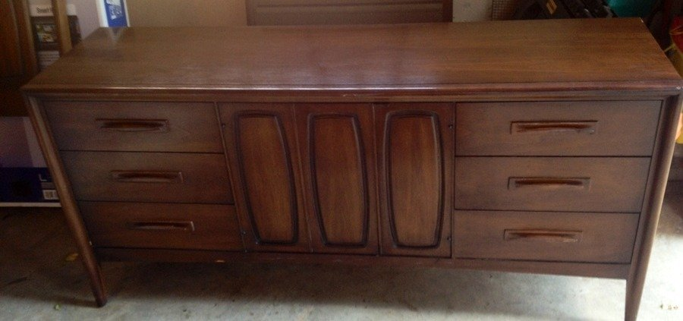
Emphasis
Creates a focal point in design created by placement, contrast or isolation.
No dominant feature in a design the eye can become bored.
Emphasis can also mean dominance.

Slide 9
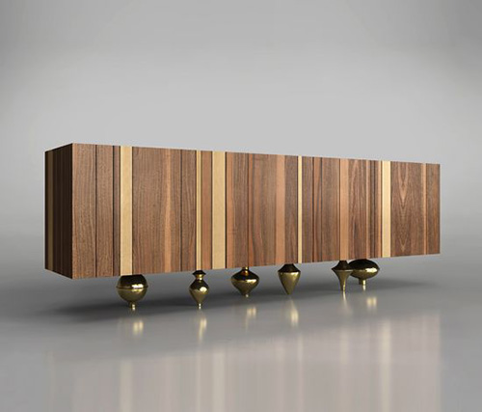
Contrast, harmony and unity
When there is an unexpected conflict in the visual elements of the design.
A twist in the design.
When one or more qualities of a design are alike.
Culmination or final point of design.
Achieved when every component, detail, element and feature and principle of design supports the central concept.

Slide 10
Past paper question related to design
No past paper questions.
Design is directly related to the HSC portfolio.
Design, management and communication will be marked in your HSC Major Project.

