Slide 1
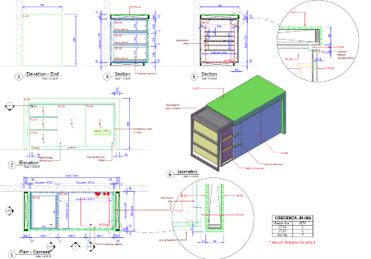
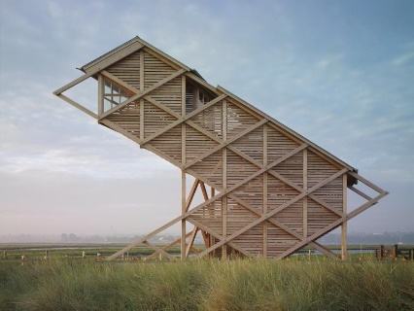
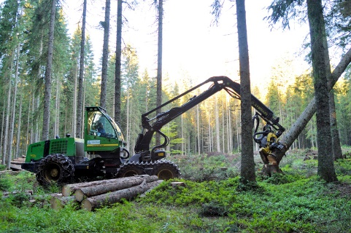
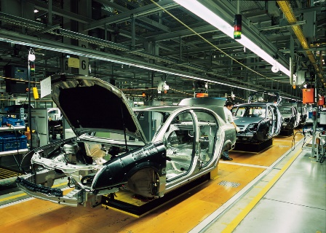
Industrial Technology
Industry Study – Structural Factors

Slide 2
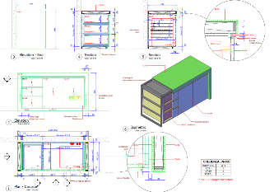
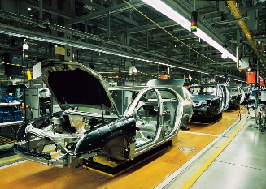
This presentation covers…
Organisation and structure
Marketing and sales
Production
Workplace environment
thactindech.weebly.com

Slide 3
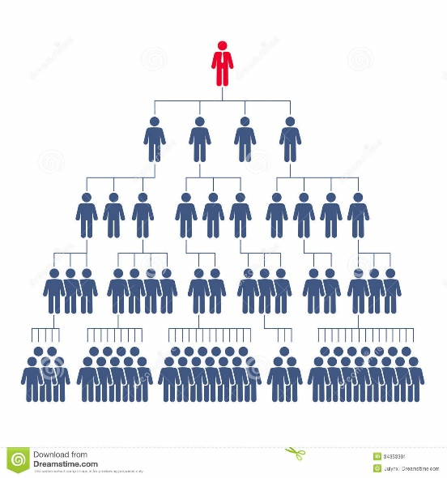
Organisation and structure
Finance:
Most companies will have a bank overdraft and an accountant who will manage the funds.
Management:
Directors control the company and meet regularly to make decisions.
Structure of companies will be under constant review as to always improve productivity.

Slide 4
Marketing and sales
Marketing: Many furniture businesses will have a showroom in their factory.
Some businesses do not advertise but receive work purely through ‘word of mouth’.
Others have specialist clients and you cannot walk in off the street to buy their products.
Sales: most companies will specialise in a certain product like aluminium windows.
A sales rep might often represent a company and seek clients by visiting carpenters or builders.
Some companies will sell through their front office and though internet sales.

Slide 5
Production
Design & planning
Materials sawn
Most companies will have a production process that they follow each day.
This will be continually reviewed to make it more efficient.
Delivery & installation
Edge finishing
Quality control check
Hinge machining
Fitting of doors and tops
Assembly

Slide 6
Workplace environment
Businesses will always encourage a happy workplace culture.
It is the law for the employer to provide a safe working environment for every employee.
Hazard control and risk assessment is an ongoing process.
Quality control is not an official policy, however internal monitoring of systems, tools and machinery is ongoing.
Following industry standards is expected.

