Slide 1
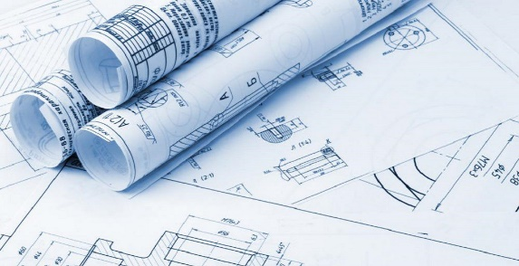
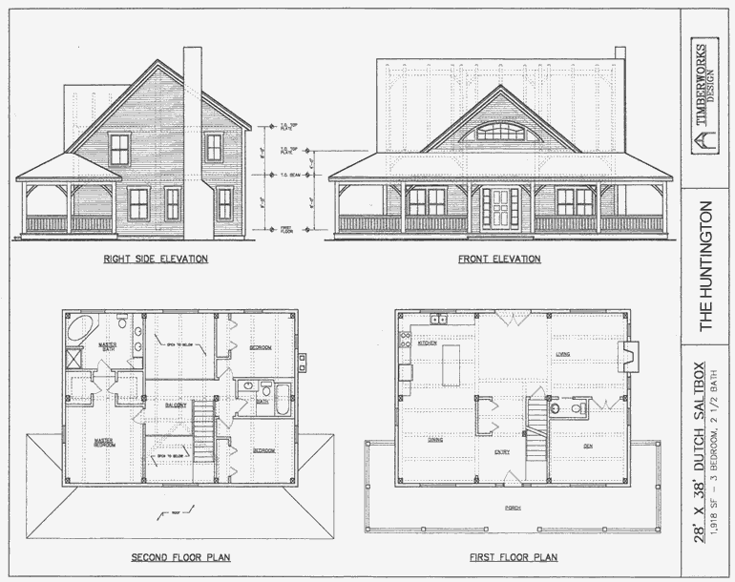
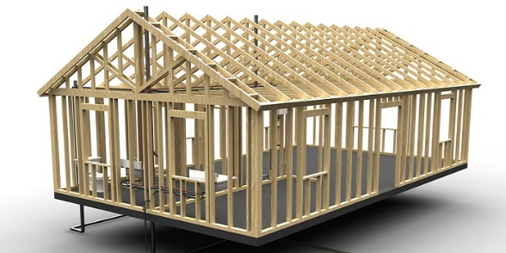
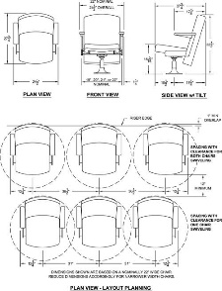
Industrial Technology
Management and Communication – Knowledge and Understanding of Project Management

Slide 2
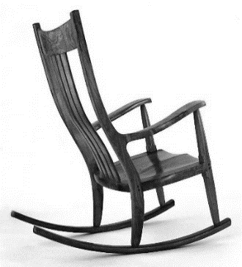
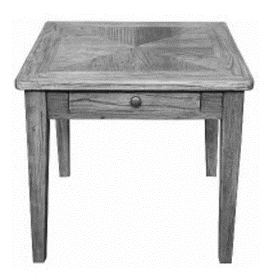
This is the topic we will be covering today
Industry Study
Design, Management and Communication
Production
Industry Related Manufacturing Technology
thacindtech.weebly.com
Industry Study
Design
Management and communication
Production
Industry Related Manufacturing Technologies

Slide 3
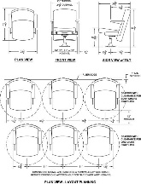
This presentation covers…
Skills in managing projects
Development of management folios
Development of skills related to research, analysis and evaluation
thactindech.weebly.com

Slide 4
Skills in managing projects
Managing refers to how production of the design is planned and organised.
Some things to consider are materials and cost…
Finance plans in your major project need to be proposed and actual. The proposed finance plan will go into your initial planning.
Legislation is something to consider especially if your project is directly related to industrial regulations.
For example is their a law on the thickness or safety of the glass you might use in your project?

Slide 5
Development of management folios
Ethical issues, cultural beliefs and ecological sustainability are all factors to consider when thinking about your project design.
Ethics: values by which people live their lives.
Cultural: the way people live and refers to the beliefs, ethics, habits, skills and morals of a community of people.
Ecological sustainability: limits placed on the design so the earth’s natural resources are sustained (not depleted or damaged).

Slide 6
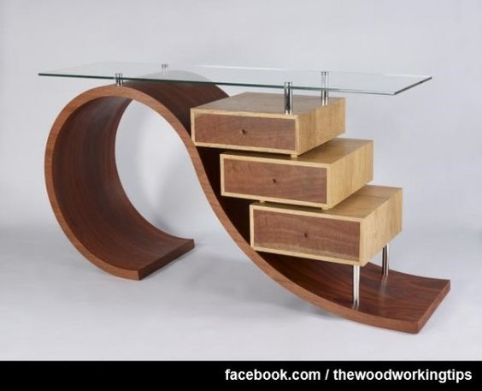
Development of skills related to research, analysis and evaluation
You must show clearly what has been gained from research for your design and how you intend to use it.
All researched needs to0 be evaluated and conclusions determined and documented in relation to the statement of intent.
Analysis is a detailed examination of the idea, process, material or technique based on research, experience or calculation.
Evaluation needs to be throughout the project and is usually of ideas, materials, processes and techniques.

