Slide 1
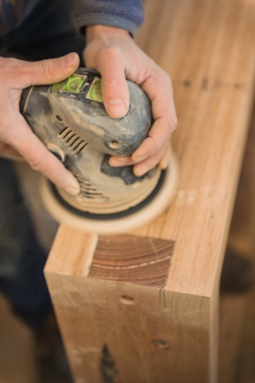
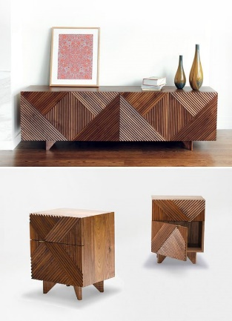
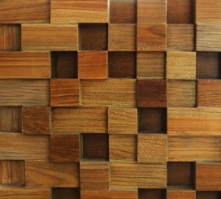
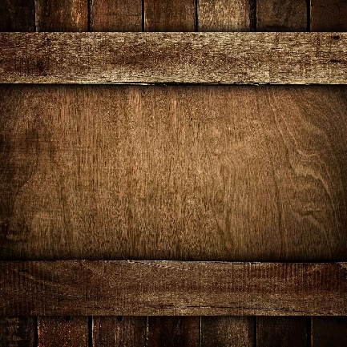
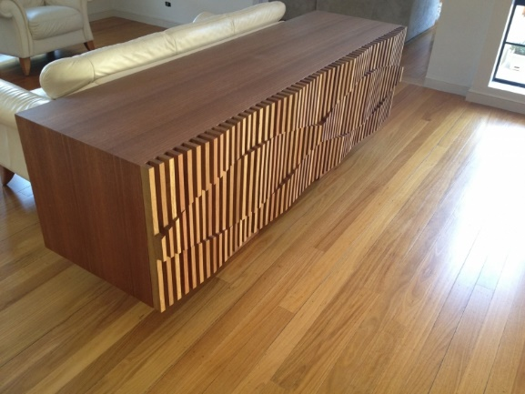
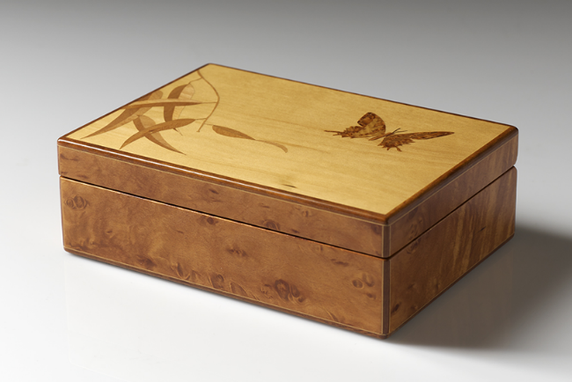
Industrial Technology
Design – Elements of Design

Slide 2
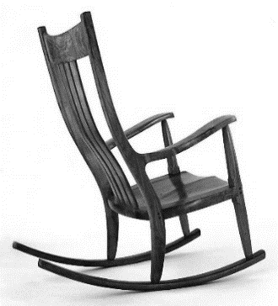
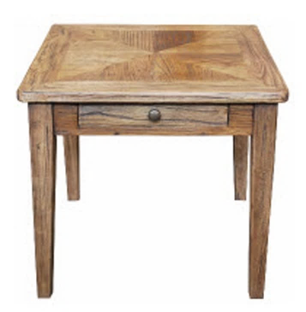
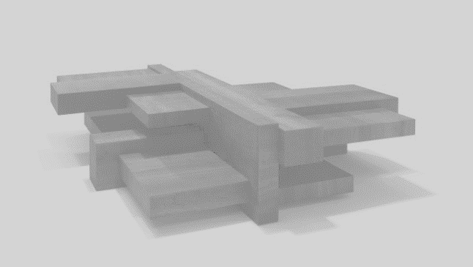
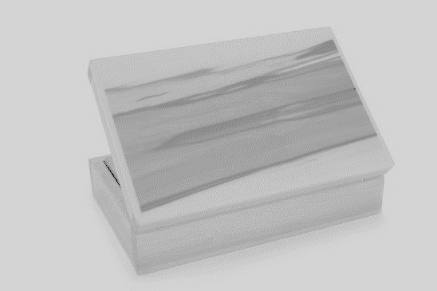
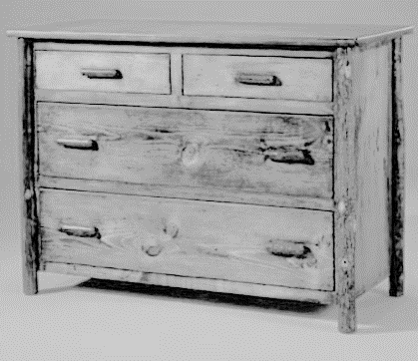
This is the topic we will be covering today
Industry Study
Design, Management and Communication
Production
Industry Related Manufacturing Technology
thacindtech.weebly.com
Industry Study
Design
Management and communication
Production
Industry Related Manufacturing Technologies

Slide 3
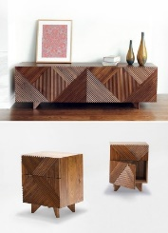
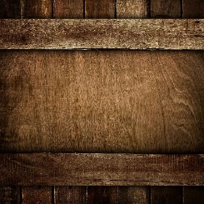
This presentation covers…
Line, direction and style
Shape and size
Colour
Texture
thactindech.weebly.com

Slide 4
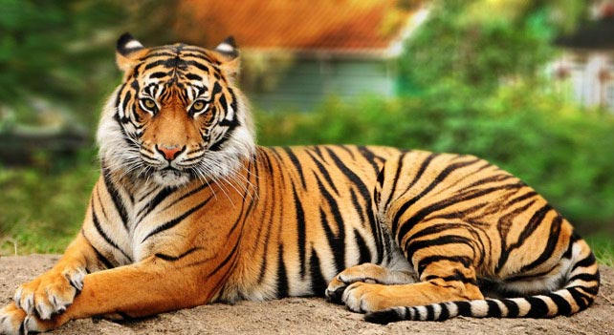
Line, direction and style
The human eyes form connections with lines, from a series of points.
Lines form direction and from direction you can make a specific style.
Style comes from your experience and what you are passionate about.
A line has a psychological impact that is determined by its direction and weight.
It communicates emotion through its character and direction.
For example striping on a tiger…

Slide 5
Shape and size
Shape and size is created through a closed line which is two dimensional.
When you add depth it becomes 3-D, this is known as form.
A geometric form is regular shapes, squares, rectangles, circles, cubes, spheres, cones and other regular shapes.
Some shapes have irregular form like a snow flake or a soap bubble.
Shapes give a sensory response, like a motorbike which gives a feeling of power with strong black shapes.

Slide 6
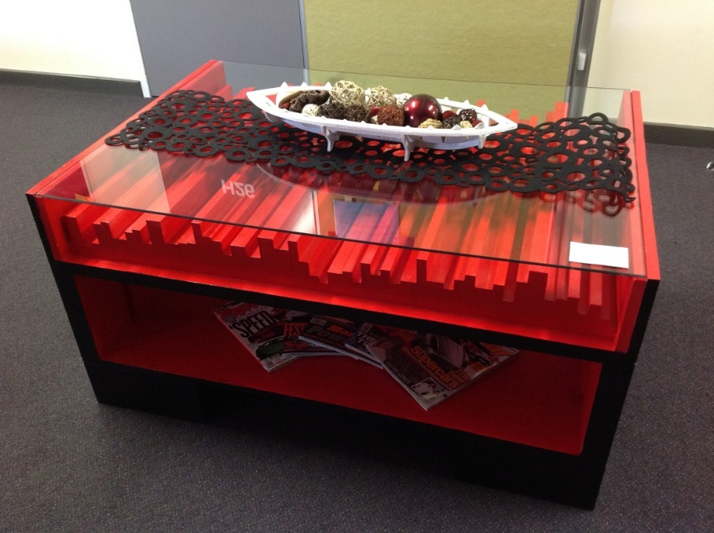
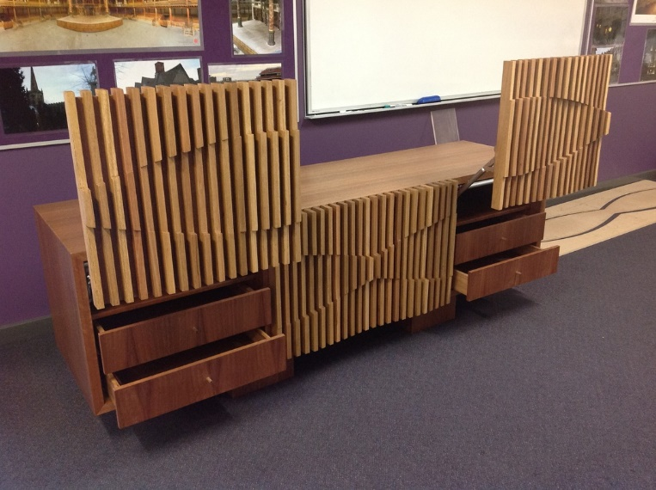
Colour
Colour is one of the most important and exciting elements of design.
The first thing a person will notice is the colour.
Careful not too use bright colours as they cause different emotions.
Bright red can cause strong emotions like anger, blue can be a calm colour and cause the eyes to relax.
Natural timber colour rarely needs to be changed.

Slide 7
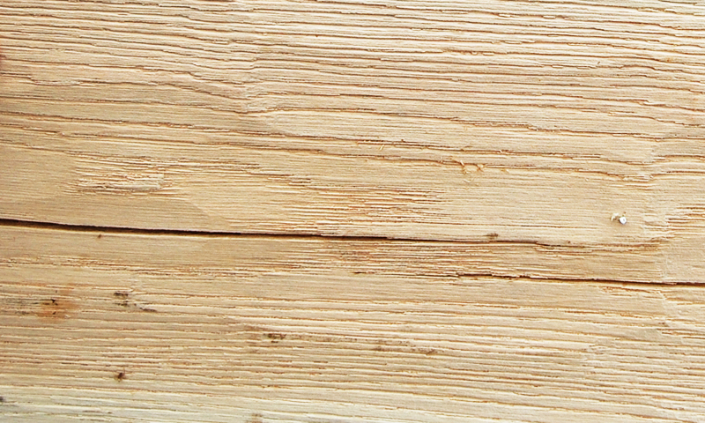
Texture
Refers to the surface of the design.
Texture is often measured through touch.
It can be visual as what you see portrays the surface.
Each timber has a different texture and roughness.
Sanding, chiselling and planing are ways of changing the texture of a piece of timber.

Slide 8
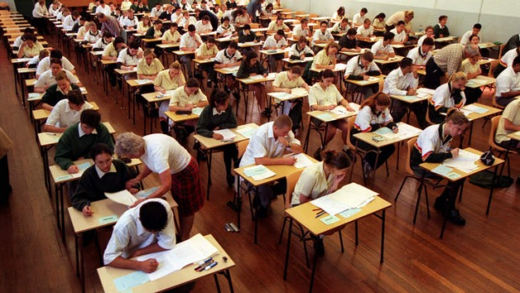
Past paper question related to design
No past paper questions.
Design is directly related to the HSC portfolio.
Design, management and communication will be marked in your HSC Major Project.

